Slide 1

DEPARTMENT OF Zoology Faculty of Science

Slide 2
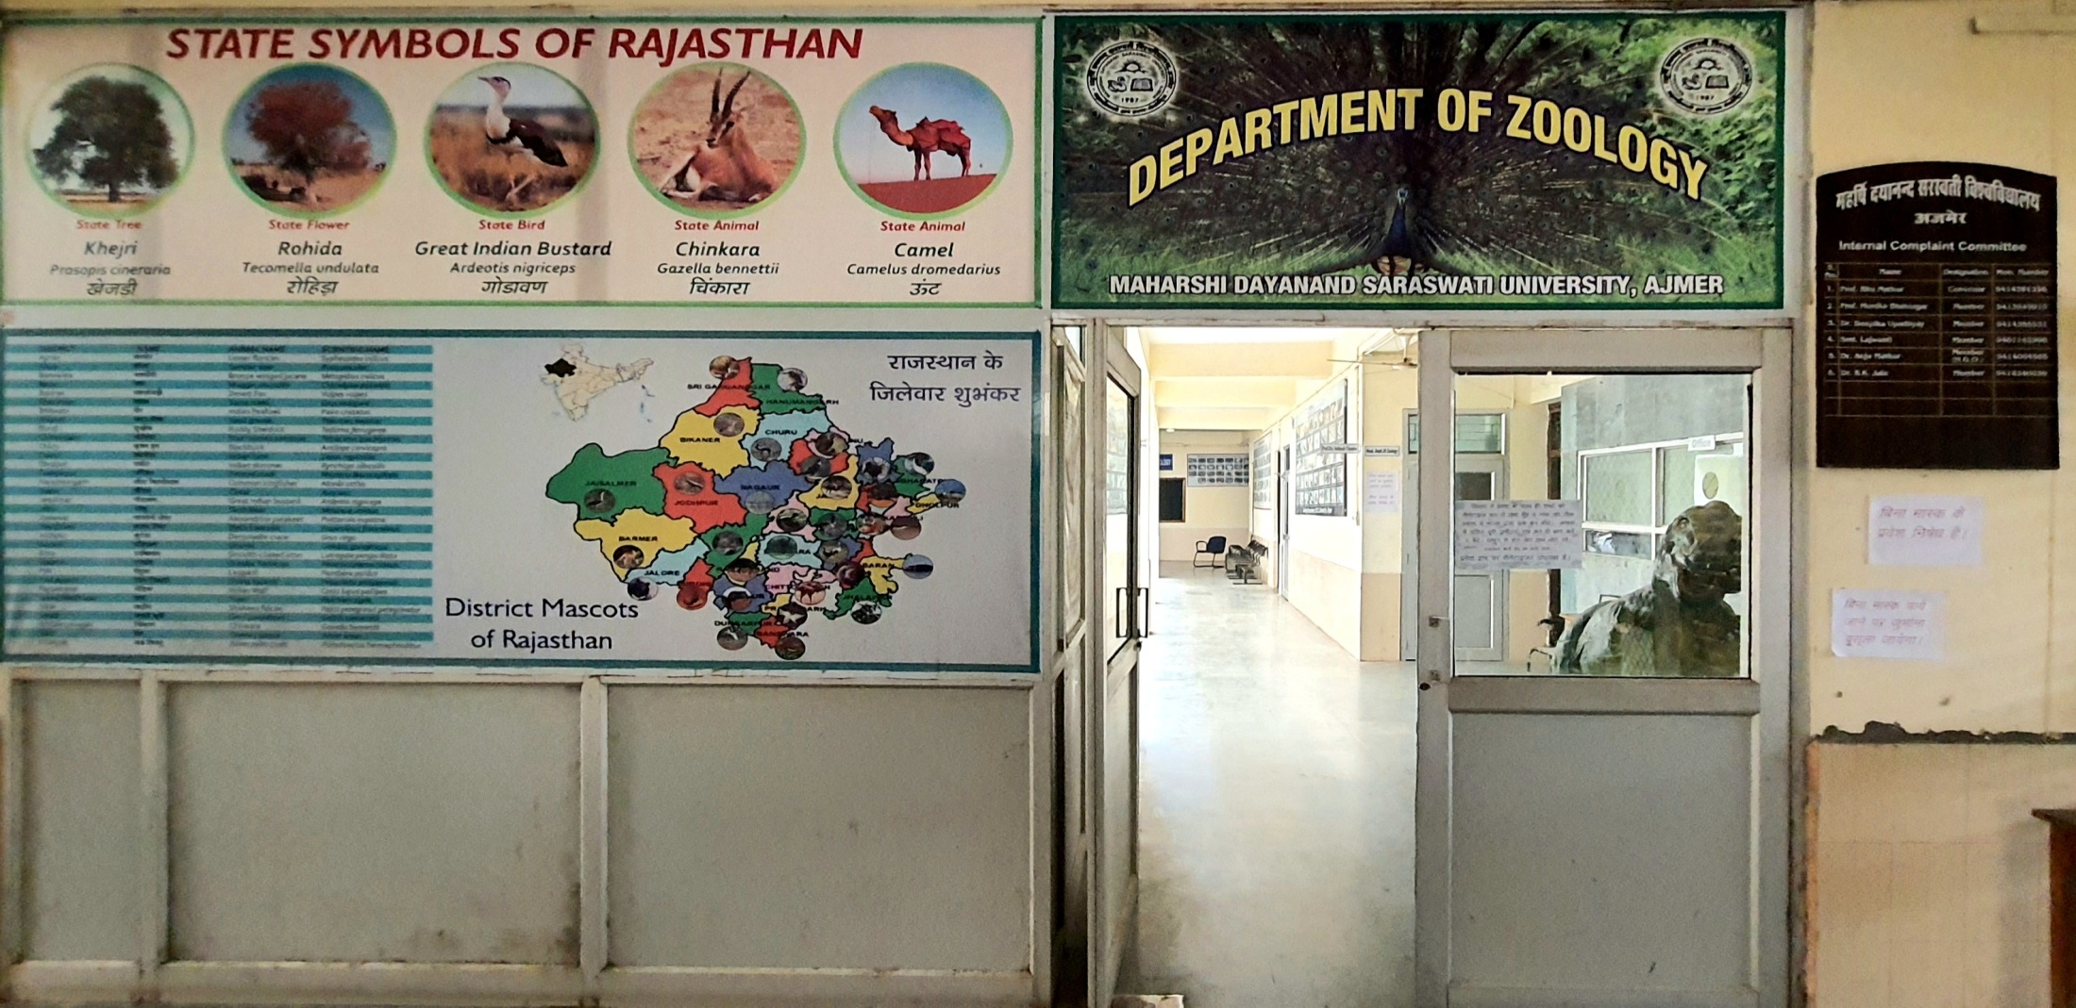
DEPARTMENT OF Zoology Faculty of Science

Slide 3
About the Department (The Foundation)
The Department was established in 1989-1990 & is now almost 32 years old.
Prof. KK Sharma took over as the 1st Head of the Department in 1989. He moulded the destiny of the Department during his tenure.
This Department is well-known Centre for teaching & research in Zoological Sciences across the country.
Zoology Research Activities were initiated (Ph.D.) in 1990 & Postgraduate teaching (M.Sc. Zoology with Specialization in Molecular and Developmental Biology) in 2000.
Self financing diploma course in Medical Laboratory Technology was offered during 1992 – 2007 & 2014 – 2016 that discontinued due to some technical issues.
Prof. Subhash Chandra took over on 5th August 2017 as Head of the Department.
Presently post graduation teaching & research specialization is Environmental Biology.

Slide 4
About the Department (Ongoing Journey)
CSIR NET based syllabus with applied & basic Zoology was introduced after joining of Prof. Subhash Chandra in the Department; for the development of students along with seminars on NET based topics & previous year questions.
Hence, from a small one room-offspring, department has grown into a well-developed Centre of teaching and research, with all the essential requisites for the pursuits of advance biology.
Its schools of specialization in Molecular Developmental Biology and Environmental Biology have attained new heights and acquired national recognition.

Slide 5
About the Department (Step by Step)
The Department is attaining new heights in terms of teaching and infrastructural development in modern / applied research.
Faculty members including guest faculties of the department are actively involved in various research areas such as Human Genetics, Epidemiology, Toxicology, Limnology, Environmental Biology, Biodiversity, animal Behaviour, Natural Resource Conservation and Molecular Developmental biology.
Some of the faculty members are recipient of various National and International Awards.
Research Papers, several books, monographs and book chapters have been published in reputed National and International Journals/Books by the Department Faculty members.

Slide 6
About the Department (Step by Step)
The Department has produced more than 26 Ph. Ds and 36 M.Phils during last 32 years.
Besides, the Department of Zoology has received grants from various national and international R & D agencies such as UGC, DST (including DST-PURSE), DBT (including DBT Builder Program), CSIR, etc.
The strength of the Department lies in its highly qualified and devoted teaching staff, diverse research interests in basic and applied sciences, modern teaching aids along with dedicated students.

Slide 7
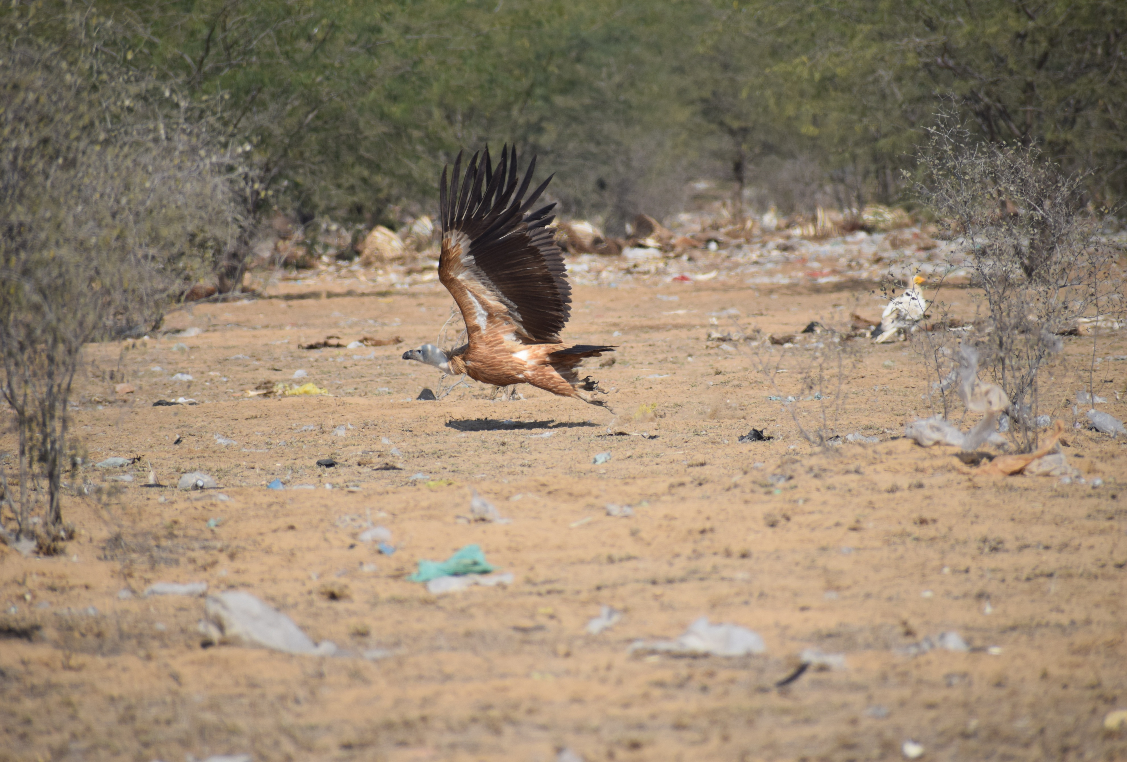
Policies for Future

Slide 8
Vision of The Department
Holistic development of students and to enable them to contribute effectively for the welfare of society in this dynamic era by discovering fundamental knowledge of the living world: from the behavior of single molecules to dynamics of cells, organisms, populations, and interactions of biological systems with our planet.
We are dedicated to developing innovative training experiences for the next generation of biologists, and for building an inclusive learning environment that unites scientists from diverse disciplines & life experiences to creatively address critical questions for today’s world.

Slide 9
Future MISSION of Department
To develop infrastructural facility and introduce tools & techniques in relevant fields.
To undertake research projects in different fields & conduct quality research in frontier areas.
To publish high quality research papers in different fields.
To produce leadership in science and technology.
To prepare responsible trained manpower in animal sciences, teaching and research.
To sensitize human society for animal welfare, conservation and protection of biodiversity.

Slide 10
To provide transformative, holistic & value-based immersive learning experiences to students.
To contribute meaningfully in solving pressing societal problems and well-being of the people.
To be a hub of original productive research and innovative thinking.
To be recognized for quality research
To be the largest provider of quality education in India.
Reinvent ourselves in response to the changing demands of society with high moral values as a good citizen.

Slide 11
QUALITY POLICY OF THE DEPARTMENT
Giving research oriented knowledge to students by involving them in seminars, workshops, conferences and projects etc.
Conducting educational field trails to various places to gain the knowledge of habit and habitat of the wild life.
Preparation of CSIR NET exam through NET based syllabus, seminars and practice tests.
To create awareness of IN SITU conservation of wild life.

Slide 12
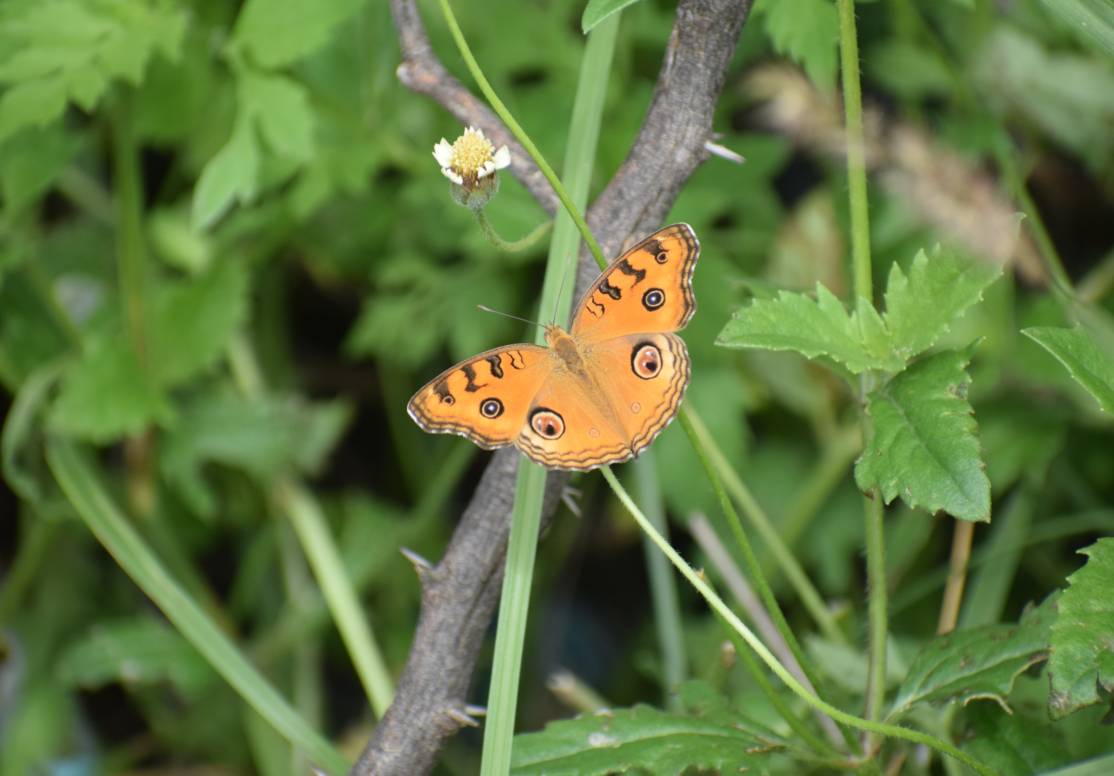
Basic Setup

Slide 13
Courses offered
Year of Establishment: 1989
Names of Programmes Offered:
M.Sc. Zoology (Semester Scheme) (Specialization in Environmental Biology)
Ph.D. (Zoology)

Slide 14
Present Scheme of Examination
Semester I
Paper No. | Paper Nomenclature | Total Marks
Paper -1 | Taxonomy, Biodiversity and Wildlife | 50
Paper -2 | Cell and Molecular Biology | 50
Paper -3 | Genetics and Evolution | 50
Paper-4 | Immunology and Biotechnology | 50
Paper-5 | Practical | 100
 | Total | 300
Semester II
Paper No. | Paper Nomenclature | Total Marks
Paper -6 | Structure and Function of Invertebrate | 50
Paper -7 | Biochemistry | 50
Paper -8 | Physiology and Endocrinology | 50
Paper-9 | Developmental Biology | 50
Paper-10 | Practical | 100
 | Total | 300

Slide 15
Scheme of Examination
Semester III
Paper No. | Paper Nomenclature | Total Marks
Paper -11 | Biology of Chordates | 50
Paper -12 | Ecology | 50
Paper -13(B) | Special Paper: Environmental Biology | 50
Paper-14(B) | Special Paper: Environmental Biology | 50
Paper-15 | Practical-I (Based on Paper 11 & 12) | 50
Paper-16 | Practical-II (Based on Paper 13(B) & 14(B)) | 50
 | Total | 300
Semester IV
Paper No. | Paper Nomenclature | Total Marks
Paper -17 | Biological Techniques and Biostatistics | 50
Paper -18 | Animal Behaviour | 50
Paper -19(B) | Special Paper: Environmental Biology | 50
Paper-20(B) | Special Paper: Environmental Biology | 50
Paper-21 | Practical-I (Based on Paper 17 & 18) | 50
Paper-22 | Practical-II (Based on Paper 19(B) & 20(B)) | 50
 | Total | 300

Slide 16
Faculty Profile
Name: Prof. Subhash Chandra
Qualification: M.Sc.; Ph.D. (Zoology)
Designation: Professor and Head of the Department
Specialization: Wildlife Science, Biodiversity Conservation, Animal Behaviour
Citation Indices (Based on Google Scholar)
Name of Faculty | Citation |  | H-index |  | i10 index
 | All | Since 2015 | All | Since 2015 | All | Since 2015
Prof. Subhash Chandra | 360 | 318 | 11 | 11 | 15 | 11

Slide 17
Number of Teaching Posts Sanctioned, Filled and Actual (Professors/Associate Professors/Asst. Professors/Others)
Position | Sanctioned | Working | Vacant
Professor | 1 | 1 | -
Associate Professor | 2 | - | 2
Assistant Professor | 1 | - | 1

Slide 18
Present Teaching members
Designation | Name
Permanent Faculty
1 | Prof. Subhash Chandra
Guest Faculty
1 | Dr. Aarti Sharma
2 | Dr. Vivek Sharma
3 | Dr. Aparna Sathpathy
4 | Miss. Nikita Kundu

Slide 19
academic support staff (technical) and administrative staff:
Designation | Sanctioned | Filled | Actual
Junior Technical Assistant |  | 1
Aquarium Assistant |  | 1
Lab Assistant | 1 | 1 | 1
Lab Boy | 1 | 1 | 1
IV Class | 1 | 1 | 1

Slide 20
Infrastructure and Facilities
UV Visual Spectrophotometer
Spectrophotometer
Microtome
Centrifuge
Gel Electrophoresis
Thin Layer Chromatography
Micro Photography
pH Meter (Digital / Portable)
Sterozoom Trinoculor Research Microscopes
Sterozoom Trinoculor Dissection Microscopes

Slide 21
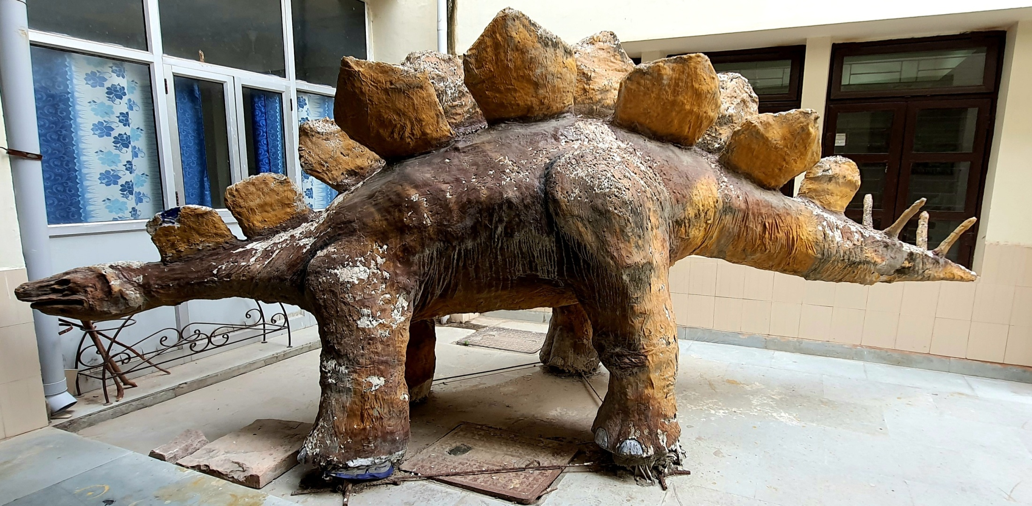

Slide 22
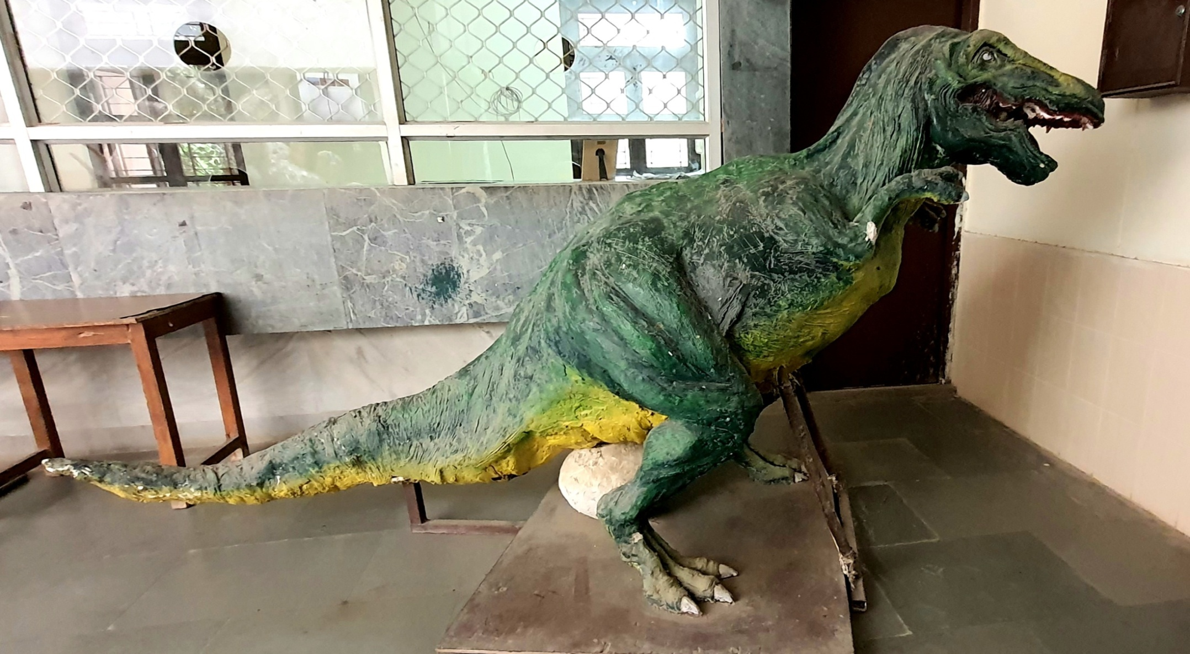

Slide 23
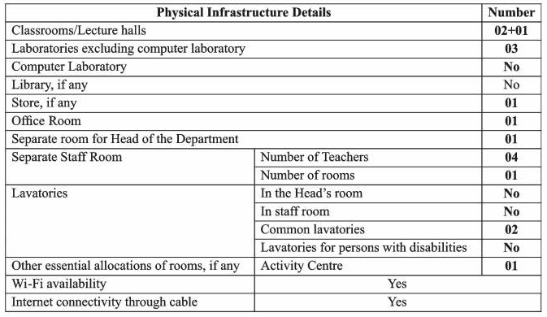
Infrastructure and Facilities

Slide 24
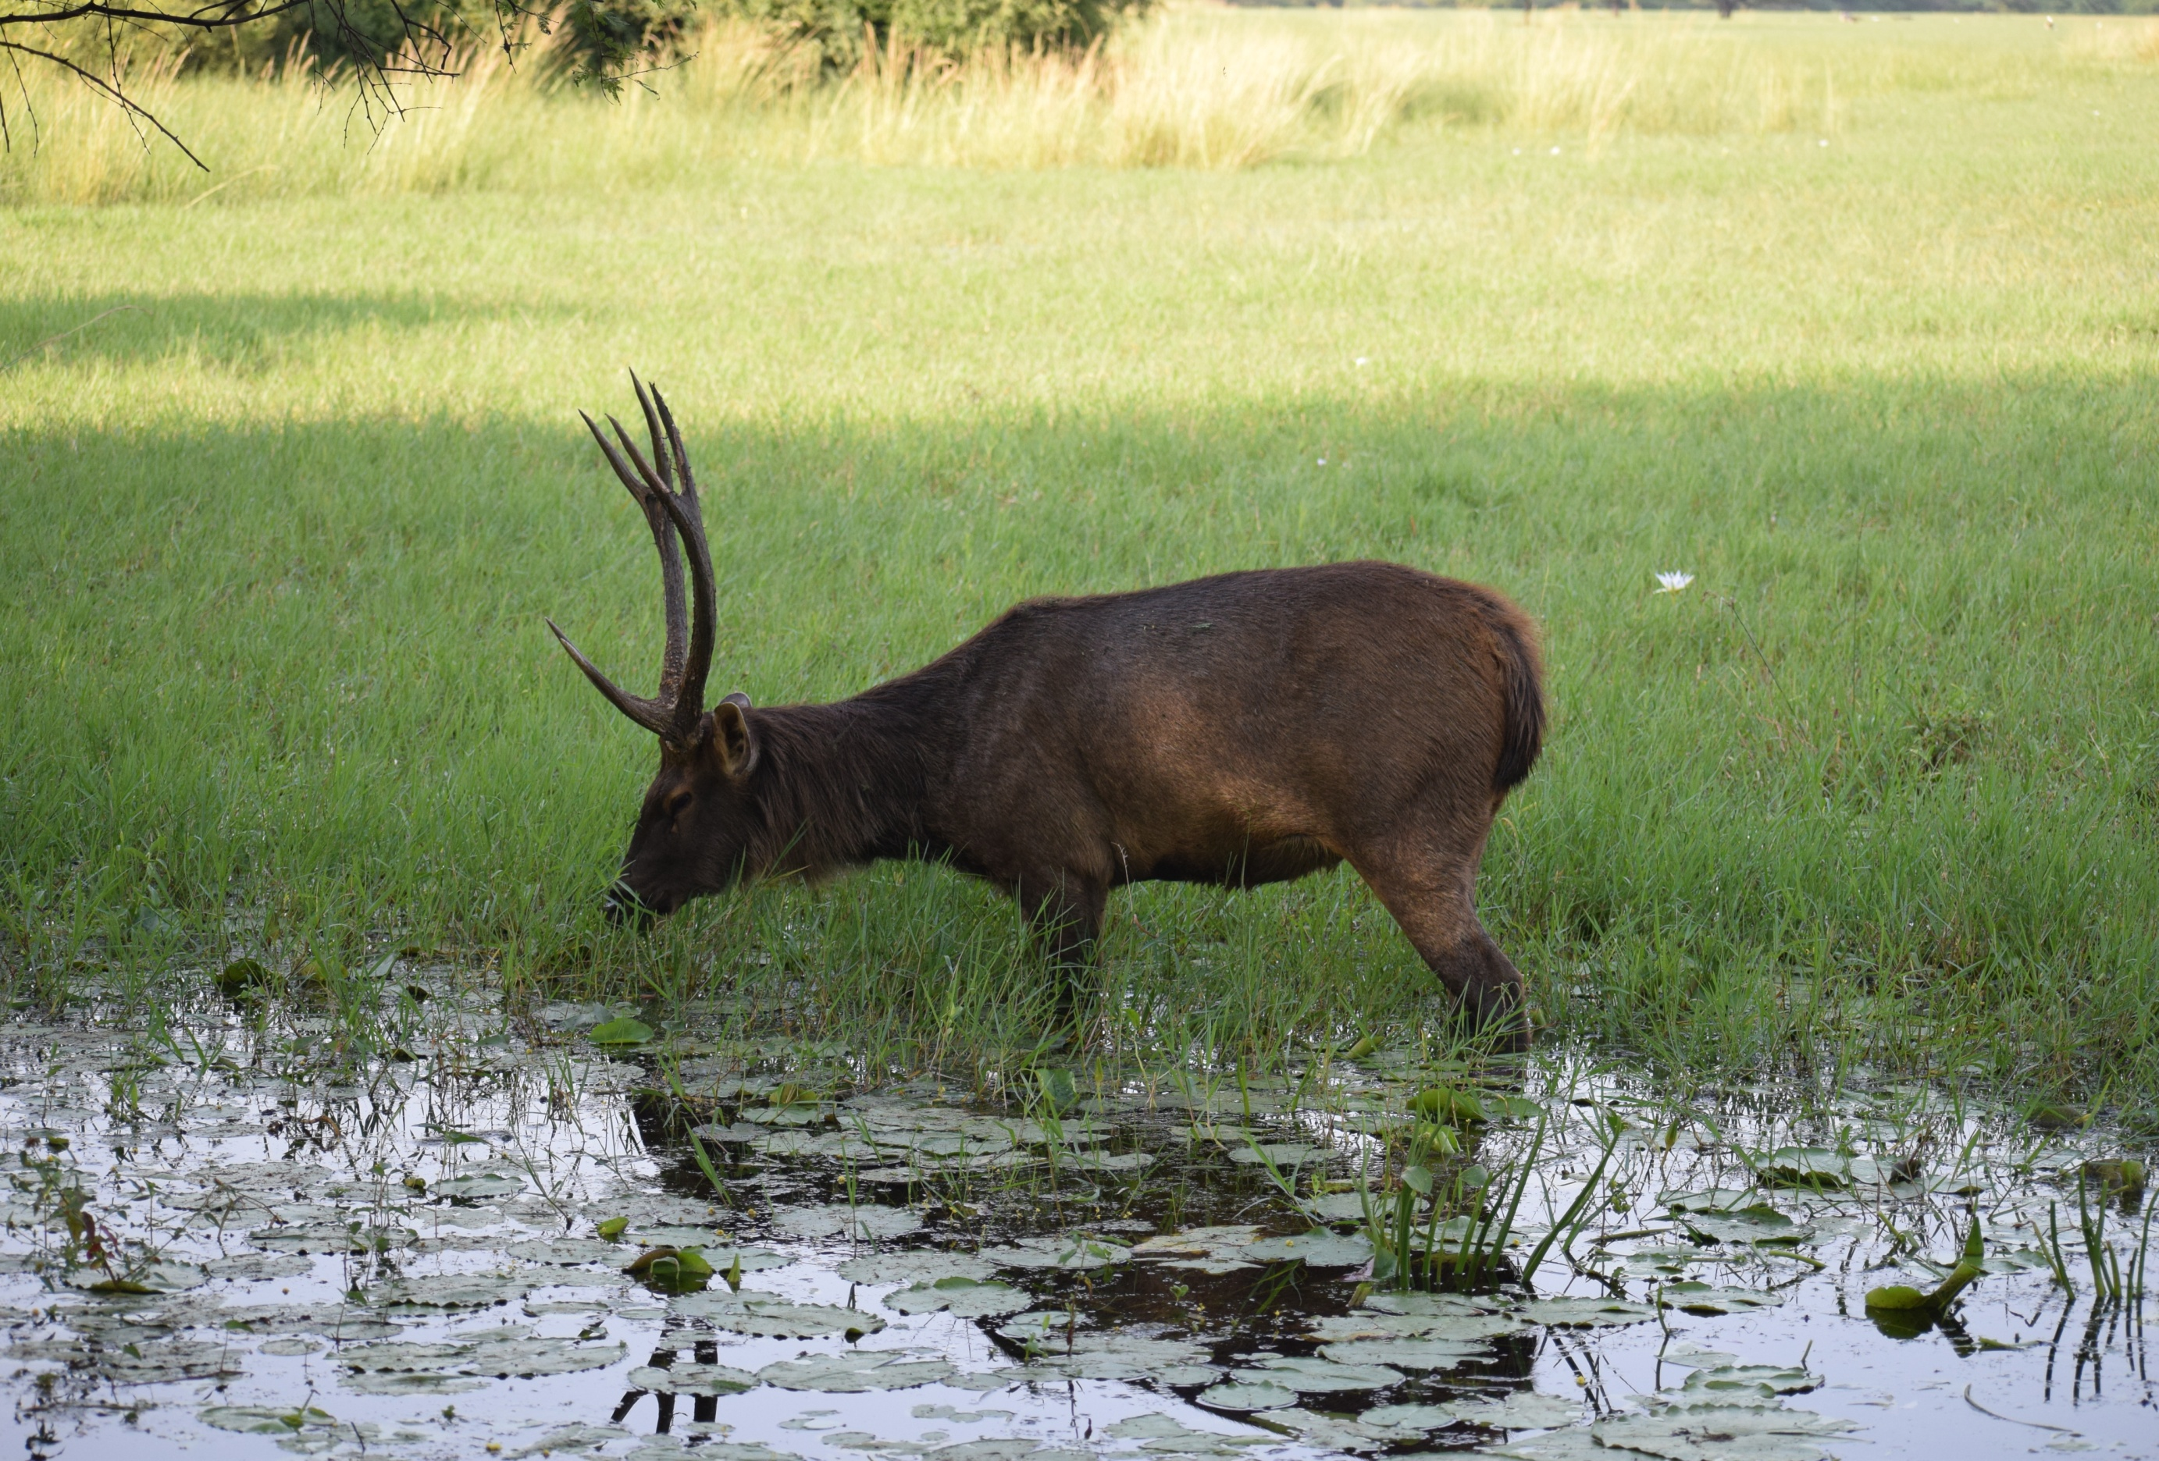
Research Thrust Areas

Slide 25
RESEARCH AREAS
Prof. Subhash Chandra
Animal Behaviour / Ethology
Wildlife Biology/ Biodiversity Conservation
Natural Resources Conservation

Slide 26
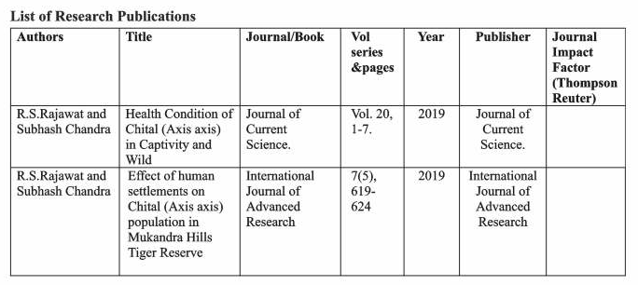
Latest Publications

Slide 27
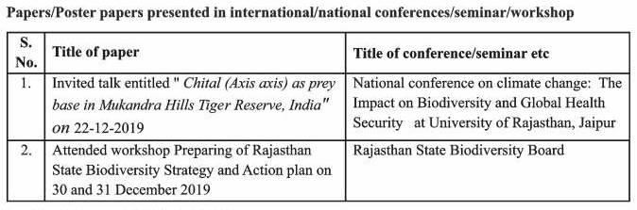
Other latest Scientific Contributions

Slide 28
Recent Departmental Activities
Wildlife Week 2021 (Photography Competition, Wildlife Quiz Competition, Extempore, Poster Making, Slogan Writing etc.)
Teachers Day, 2021
Wildlife Week 2019 (Photography Competition, Wildlife Quiz Competition, Extempore, Poster Making, Slogan Writing etc.)
Wildlife Week 2018

Slide 29
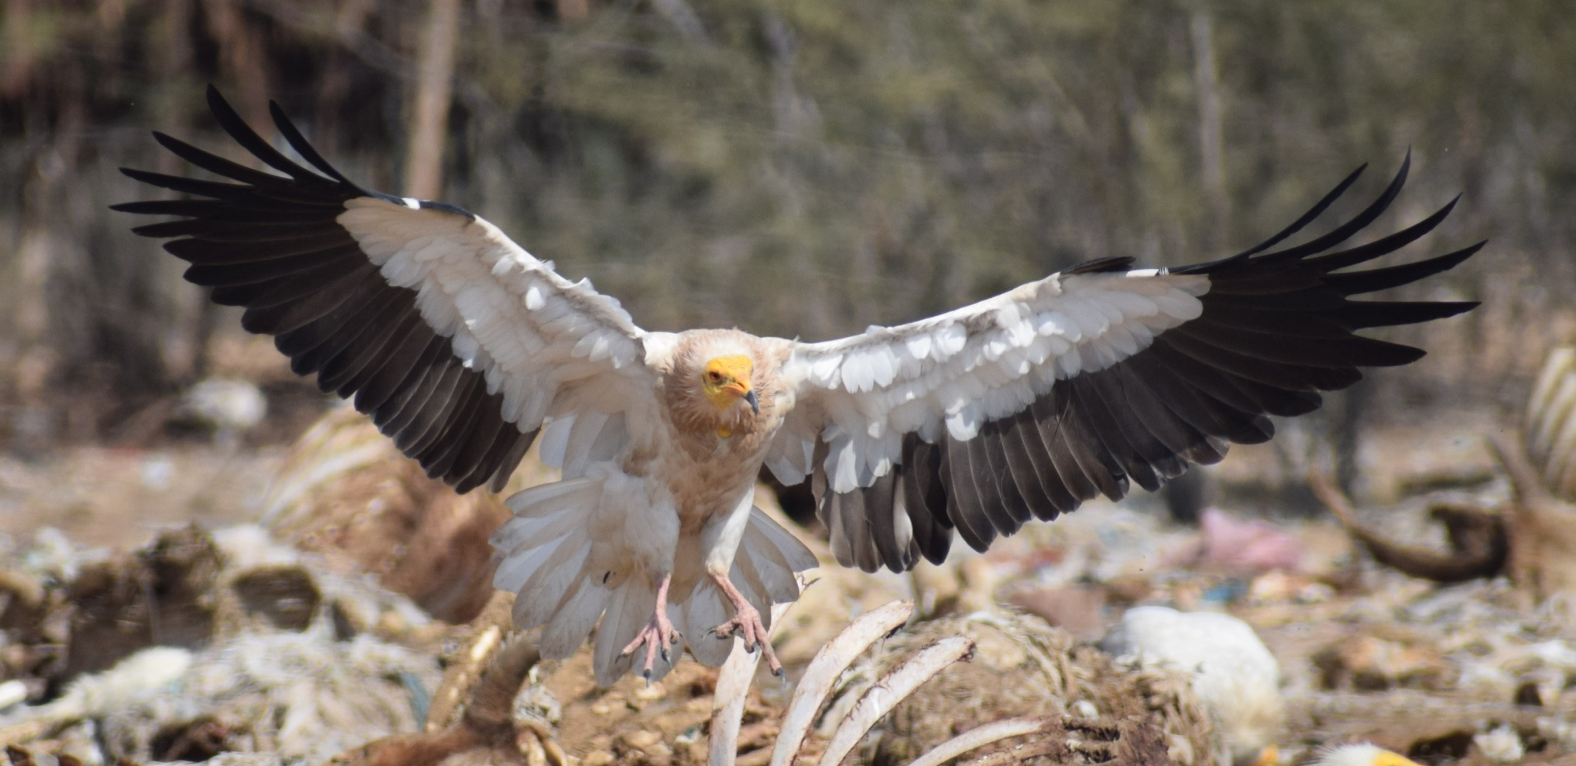
Achievements

Slide 30
Research Doctorate degree Awarded from Department of Zoology
Candidate Name | Year
Pramila Gupta | 1991
Nagendra Nagpal | 1992
Archana Khandelwal | 1992
Harish Gautam | 1993
Sunita Singh | 1995
Piyush Salodiya | 1995
Ashok Singh Bhadoriya | 1996
Kalpana Soni | 1997
Karuna Showbhawat | 1998
Ashok Kumar Gupta | 1999
Rashmi Sharma | 2001
Indu Yadav | 2001

Slide 31
Candidate Name | Year
Ratnesh Kumar Sharma | 2002
Lata Sahni | 2002
Prahlad Dube | 2003
Sarvat Nishat Khan | 2004
Yogmaya Bhobharia | 2009
Navneet Sharma | 2009
Raju Lal Sharma | 2010
Satya Prakash Mehra | 2011
Sarita Mehra | 2011
Kumud Joshi | 2012
Vivek Sharma | 2012
Poonam Singh | 2013
Shikha Mathur | 2013
Swati Tyagi | 2013

Slide 32
M.Phil. Awarded from Department of Zoology
Candidate Name | Year
Chanchal Yadav | 2000
Laxmi Sharma | 2000
Madhavi Kunwar Veer | 2000
Raj Pal Khokhar | 2000
Reena Mathur | 2000
Rekha Goyal | 2000
Mahendra Solanki | 2007
Narendera Singh | 2007
Puneet Sharma | 2007
Rajmohan Meena | 2007
Tripti Dadheech | 2007
Shikha Mathur | 2007
Umesh Dutt | 2007
Vikas Pareek | 2007

Slide 33
M.Phil. Awarded from Department of Zoology
Candidate Name | Year
Amit Kumar | 2008
Asha Ram Meena | 2008
Mahendra Kumar Awasthi | 2008
Manoj Kumar Rawat | 2008
Navneet Joshi | 2008
Purushottam Nagar | 2008
Ranu Tunwal | 2008
Ritu Sharma | 2008
Sandeep Kumar Sharma | 2008
Vinod Prabhakar | 2008

Slide 34
M.Phil. Awarded from Department of Zoology
Candidate Name | Year
Bhagat Kumar Meghwal | 2009
Bhanwar Lal | 2009
Jugal Kishore | 2009
Mamta Warman | 2009
Nirja Shekhawat | 2009
Pinky Khorwal | 2009
Pinky Yadav | 2009
Pramod Kumar | 2009
Ramswroop Saini | 2009
Sonal Jaju | 2009
Garima Sharma | 2009

Slide 35
NET/SET/GATE Qualified Students of Department
S. No. | Name of Student | Year | NET / JRF / SET
1 | Kanhiya Lal Sharma | 2013 | SET
2 | Sunil Dutt | 2013 | SET
3 | Rakesh Kumar Kumawat | 2016 | NET / JRF
4 | Samaram Devasi | 2017 | NET
5 | Mohd. Shakoor | 2017 | NET
6 | Nikita Kundu | 2018 | NET
7 | Prggya Gehlot | 2018 | NET / JRF
8 | Chhavi Chaudhary | 2018/2019 | GATE / TIFR
9 | Jitendra Kumar Sharma | 2019 | NET / JRF (AIR110) / GATE
10 | Gargi | 2019 | NET / JRF
11 | Arti Tiwari | 2019 | NET/JRF (AIR-68)
12 | Sneha Choudhary | 2019 | NET/JRF
13 | Akansha Verma | 2019 | GATE
14 | Shimla Choudhary | 2020 | NET

Slide 36
M. Sc. Toppers / Gold Medalists (Department of Zoology)
S. No. | Name | Year
1 | Sumitra Meena | 2010
2 | Gunjan Sharma* | 2011
3 | Priyanka Charan | 2012
4 | Sulekha Jha* | 2013
5 | Sarita Devi | 2014
6 | Ashish Kumar Jangid | 2015
7 | Meenakshi Rathore* | 2016
8 | Praggya Gehlot | 2017
9 | Akansh Verma | 2018
10 | Niharika Upadhyay | 2019
11 | Ujjwal Yadav | 2020
 | * University Gold Medallists

Slide 37
Key Strengths Weakness Opportunities and Threats for Department
Strengths
Faculties involved (Permanent / Guest Faculty) having expertise in relevant field and experience
NET Oriented Curriculum for Students
Weakness
Inadequate Permanent Staff for Research
Opportunities
Soon going to adopt CBCS System for M. Sc. Zoology
Overall Development of Students with the help of Standard Pedagogical tools
Add-on Courses may added Value in Teaching Learning
Threats

