Slide 1
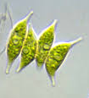
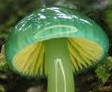
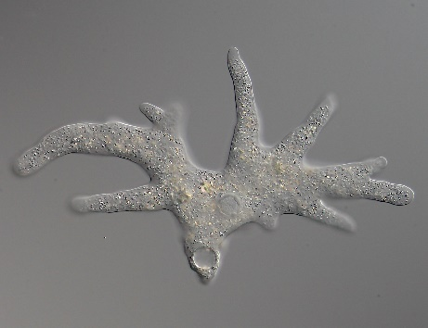


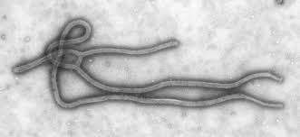
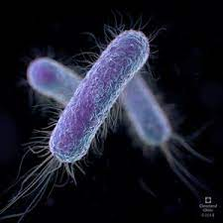

The DoM
(Department of Microbiology)
e
Unveil the hidden strength
Maharshi Dayanand Saraswati University Ajmer

Slide 2
The DoMe
Unveil the hidden strength
The DoMe is modelled in a way that it fulfils the criteria of NAAC, NIRF and even the New Education Policy
Depicts basic morphological diversity of the microorganisms: spheres, rods and filaments/spirals
Also depicts M for Microbiology and simulates μ which is the size range of microorganisms in micrometer, i.e. μm
The imperfect strokes of insignia make it wavy to depict extracellular secretions such as polymers released by most of the desert microflora to help survive in the dry arid environment near which the University (department) is situated. Thus, depicting the core microbial group and specialization of the faculty.
The sphere above also depicts the sun representing heat of the tropics
In entirety it shows a human like form with head above and hands falling down in humility depicting that not only man but the entire life on earth is indebted to the microbes. It also shows his respect towards these invisible creatures.

Slide 3
Join the DoMe
If you desire to
Quench the curiosity about life of organisms invisible to the naked eye
Understand the life as a whole through microorganisms
Expose the student to his talent, his hidden strengths and his potential
Or need answers:
How life is sustained (evolution),
whether there is life on other planets (exobiology),
how do the microorganisms live (cell biology, physiology and genetics),
how many different types of microorganisms are there (biodiversity)
what is their role,
how do they interact with other beings and what are the extremes of their life (biogeochemical cycles-ecology)
whether man can utilize them for his benefit and for the continued existence of life on earth (biotechnology, industrial, agricultural, environmental, medical, food, water and air microbiology)

Slide 4

Programs of Study
Prepare the students to occupy any work situation related to microbiology and/or Biotechnology and allied subjects.
Use pedagogy that would allow the student to put up his/her best foot forward in all walks of life.
M.Sc. Microbiology
M.Sc. Biotechnology
Ph.D.

Slide 5
M.Sc. Microbiology & M.Sc. Biotechnology
Program Outcome
The students learn Microbiology/Biotechnology and allied subjects to the extent that the knowledge and skills learnt may be used in industries, institutes and offices. Student will have practical skills in using tools, technologies and methods common to biotechnology and allied sciences. S/he will learn ethics of research and safety in laboratories.
The student will earn skills for specific technologies through projects, experiments and trainings/ workshops. This exercise is to boost the self confidence and enhance the abilities to
discuss a problem or subject
assimilate and conclude the discussion
carry out a complete scientific work process independently using appropriate statistical design and tools
critically evaluate methods and interpret results
Communicate scientific information to the general public and fraternity of biotechnologists by writing well structured reports and scientific publications and making posters and oral presentations
use ICT for learning, organizing and analyzing data and presenting the information
solve problems through computational thinking
learn through seeing, experiencing, interacting and doing
interact and give back to the society through trusteeship
working as a team member and team leader

Slide 6
Employment
The alumni of the Department are Entrepreneurs, Regulatory and Quality Specialists, Operation specialists, managers, research and development officers, quality controllers and microbiologists in reputed biotechnology, microbiology, food and dairy, biopolymer, beverage and hospitality industries viz. Ortho Clinical Diagnostics, Melbourne Australia, Biobig Healthcare Solutions Pvt Ltd, Chandigarh, Shankarpack Poland, Ranbaxy, Reliance Life Science, J Mitra Diagnostics, Thermo Fisher Scientific, Glaxo, Dominos, Redico, Cadila Pharma, CottonConnect, Sun Pharma, Dabur Pharma, IPCA, Usha Remedies, SABMiller, Zydus Cadila, Vikas WSP, Coke, Bisleri and Pepsi.
Many are scientists and professors in renowned institutes such as the National Institute of Virology Pune, All India Institute of Medical Sciences, New Delhi, Central University of Rajasthan Bandarsindari, Duke University Medical Centre Durham USA , Texas State University, University of Texas, RMIT University Melbourne Australia, Central University of Haryana Mahendragarh, MGS University Bikaner, College of Horticulture & Forestry Jhalawar, CDFST, MP University of Ag & Tech, Udaipur, Agriculture University Jodhpur, Defence Research lab Tezpur, National Center for Polar and Ocean Research, Vasco da Gama, Ministry of Food Processing Industries, GOI, New Delhi and Forensic Science Department, Kota.
Two alumni joined Indian Air Force, some opted for Rajasthan Public Services while many others are managers in banks viz. Canara Bank, Central Bank of India, Bank of Baroda, Union Bank of India, Rajasthan Gramin Bank, Rajasthan Cooperative Bank, Indian Bank, Sarv Haryana Gramin Bank and SBI.

Slide 7
Progression to Further Education
Several students joined M Phil or PhD or Post Doctoral research at International and national institutes viz. IISc Bangalore, IISER Pune, RMIT University Melbourne, National Centre for Cell Science, Pune, National Chemical Laboratory Pune, Defence lab Jodhpur, IIT Jodhpur, CAZARI Jodhpur, CDRI Lucknow, IITR Lucknow, NIO Goa, IARI Delhi, IIT Delhi, NII Delhi, CSIR-IGIB Delhi, Defence lab Gwalior, Defence lab New Delhi, IISER Mohali, BITS Pilani, BISR Jaipur, FRI Dehradun, NDRI Karnal, NDDB Anand and Universities: DU & JNU, New Delhi; BHU, Varanasi; GBPUA&T, Pantnagar; MSU, Vadodara, PU Chandigarh CUoR, MDSU, Ajmer JLNTU, Hyderabad, KGMU, Lucknow. There is a record of 87 students that qualified National level tests such as NET, GATE and SLET.

Slide 8
Subject Weightage in Programs of Learning

Slide 9
PEDAGOGY
Learner-centered education
Microsphere: https://microsphere.wooqer.com/loginRegister.do#A platform provided by Wooqer to deliver presentations (powerpoint and video) to the students, obtain assignments, provide literature and extra teaching material to the students.
Online classes: Zoom, Microsoft Team, Google Meets, Canvas
Power point presentations
Chalk-board, interactive board, visualizer
Socratic seminar
Student seminars to develop presentation skills
Library hours
Tracking and site seeing for aquatic, lithic and edaphic microflora. Showing students features like microbiotic crusts, rock varnish, lichens, biofilms, wood rot fungi, root nodules, rhizosheath, algal flocks, micro crustacean and microphyte blooms etc.
Open laboratory 24x7
Hands on Experience: Short term projects in three semesters and long-term project in fourth semester.
Notes:
(NAAC 20%) (NIRF 30%) Teaching, Learning, Evaluation & Resources

Slide 10
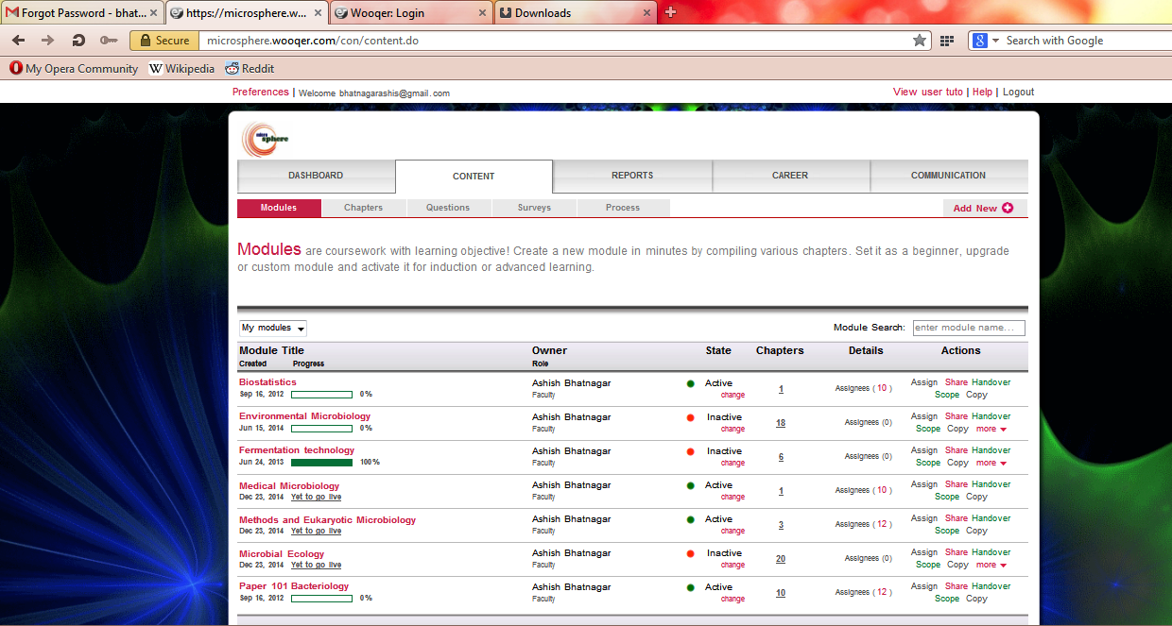
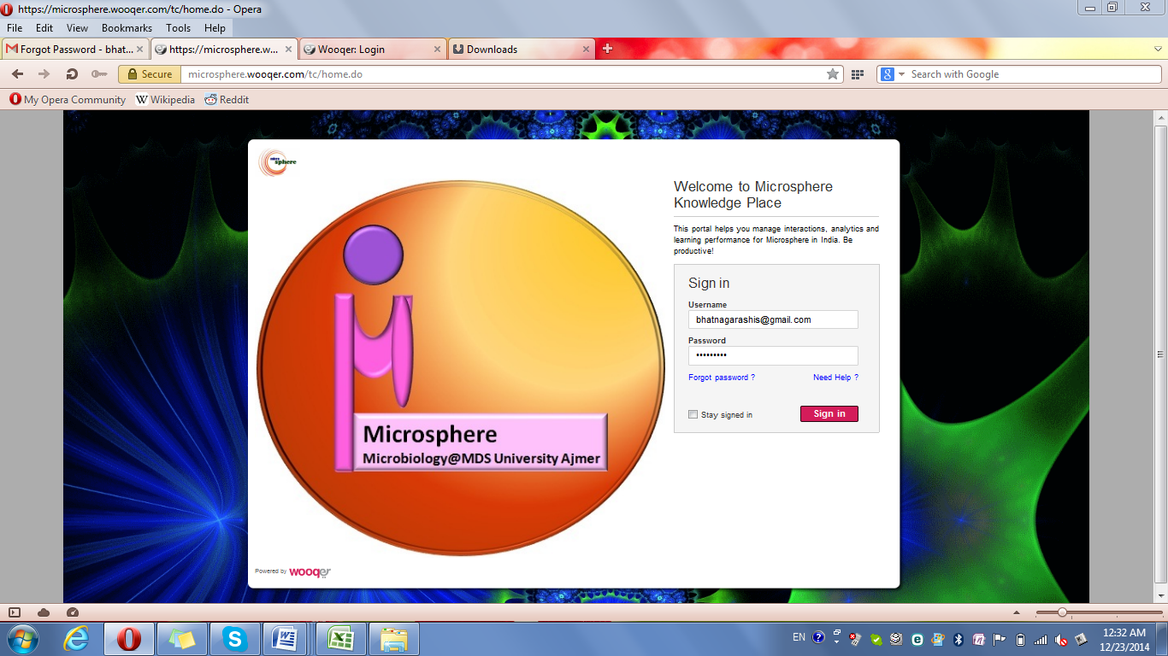
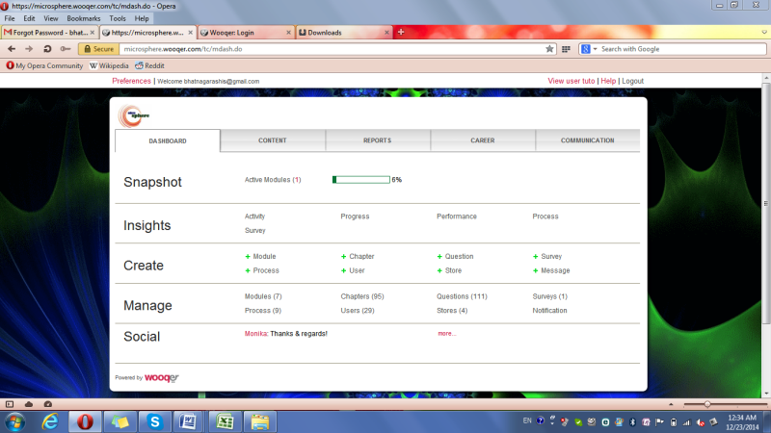
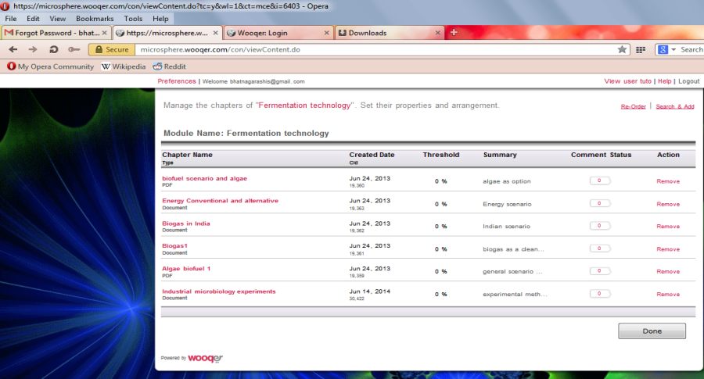
First to provide students with lecture presentations, videos, documents and other resources online on Microsphere using Wooqer platform since July 2012
Notes:
First to provide students with lecture presentations, videos, documents and other resources online on Microsphere using Wooqer platform

Slide 11
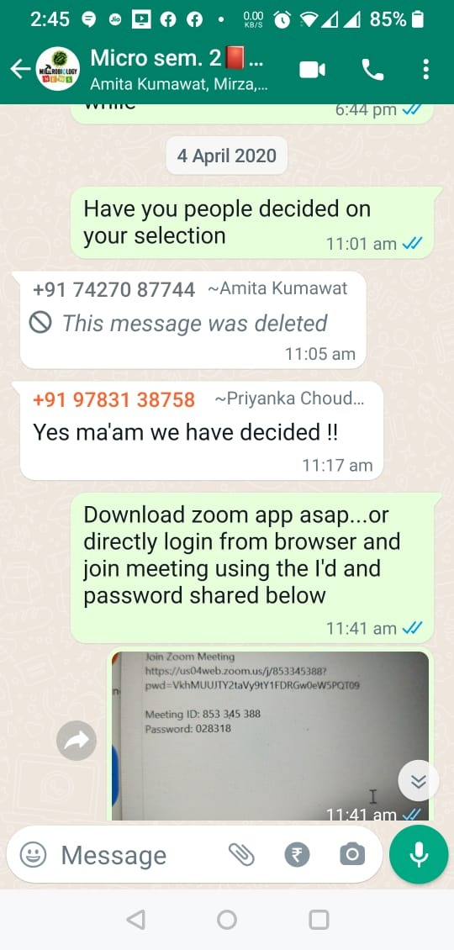




First to begin online classes in the University with the first lockdown during Covid19 since 4.4.2020

Slide 12
Curricular Aspects – Most Progressive and forward looking
Curriculum Design and Development
Modular, Semester, True CBCS, 8 specializations since 2015-16. One of the best in the nation
Academic Flexibility
Feedback System
Also target holistic development, Introduction of soft skill course, hygiene, scientific writing, seminars, short- and long-term projects
Focus on employability, entrepreneurship and skill courses and skill development programs through workshops
Includes program objectives and program outcome
Course objective, course outcome to be added this year
Credit system and choice offered that includes interdisciplinary option with no restrictions on minor elective subject to be chosen by the student.
Freedom in the use of the time-frame of the courses and inter-disciplinary options
Sensitize to cross-cutting issues professional ethics, bioethics, development of creative and divergent competencies. Gender, Environment, City, People and country sensitization
Curriculum Enrichment
Introduced alumni and industry feedback used to add courses on Good Manufacturing Practices and Industrial Hygiene
Holistic Development
Soft skill foundation courses, Anandam, hygiene, scientific writing, public speaking through seminars, short- and long-term projects, Skill workshops
Responsibility Sharing through Laboratory Management, Germplasm Management, Fabrication activities, PG club and alumni activities
Notes:
(NAAC 15%)

Slide 13
NEP: Multiple Entry and Exit System
“We have provided for multiple exit and entry options for students starting with secondary education stage and going all the way into undergraduate and postgraduate education and research. Even though a student may discontinue his/her studies in different phases he/she will be eligible for re-entry and continuing education into the higher levels, for which adequate thought has been given in the formulation of the Policy.” Page 29, NSQF guidelines Page 2
Perhaps throughout the Nation, M.Sc. Microbiology, M.Sc. Environmental Science and M.Sc. Biotechnology programs of the University were the first to allow multiple entry and multiple exit system in PG degree programs.
Unfortunately, the Academic Council recently discontinued it after 2021. This Modular system allowed exit to successful candidates with either PG Certificate/PG Diploma/PG Advanced Diploma/M.Sc. degree after I/II/III/IV semester, respectively and even re-entry if desired within two years to complete the program.

Slide 14
Skill Enhancement Courses (SEC) as workshops
Credits may be earned through Workshops/Trainings opted by the students on subjects like:
  Aseptic Techniques and Laboratory safety
  Cultivation and maintenance of microbes
  Biosafety, Biohazards, Bioethics
  Biofertilizer production
  Mushroom cultivation
  Waste remediation
  Food safety and hygiene
  Cheese making
  Yeast/Spirulina production
  Biofuel production

Slide 15
Mentors/Advisors
System of Mentors/Advisor for 4-5 students in each batch, in view of growing depression and psycho-social problems amongst students
  To guide the students in all academic affairs like selection of courses as per their desire of specializations, problems of communication etc.
  Listening to the problems of the students and counsel them for solutions

Slide 16
Financial Assistance
For the first two students in the merit
Jaganbai Mayadevi Scholarship (5%)*
Professional Faculty Fund Scholarship (5%)
For the socially and/or economically challenged students
Scholarships and/or full fee refund by the Rajasthan State Department of Social Justice (10-20%)
*Not in M.Sc. Biotechnology

Slide 17
Faculty at
The DoMe
Microconcern: The PG Club
Biodictyon: The Alumni Interface
Homo sapients: The Lab managers
ConServe: In service of nature
Activities Beyond Syllabus
MISSIONS
The DoMe: Unveil the Hidden Strength
Microconcern: All that concerns
Biodictyon: The network of Life
Homo sapients: The wise, insightful and perceptive
ConServe: In service of Nature
Laboratory and Germplasm Management: Students are made in charge of laboratories and germplasm collection in rotation making them responsible and learn laboratory management.
Notes:
Sapient: Wise, insightful, perceptive

Slide 18
Culture
Literature
Sports
Awareness
BioTik: Khurana Brain Storms
ZoomIn-Wall magazine
Madhavkar Campaigns
ConServe
Understanding and serving nature
Science & Art
MICROCNCERN
The PG Club

Slide 19
Microconcern: The PG club
All that concerns
  Microbiology Birthday:
  17 September the day in 1676, when first man on earth –Anton von Leeuwenhoek saw and described microorganisms. Declared as International Microorganism Day
  ConServe: In Service of Nature:
  Tracking local streams, hills, desert and forests for algal/fungal collections and microbiological features such as rock varnish, cryptobiotic crusts, algal flocs.
  ZoomIN: Wall magazine
  आत्रेय Series of Lectures of Eminent Microbiologists/Biotechnologists
  माधवकर Series of Awareness Campaigns:
  After Madhavkar-the physician of 8-9th century. He was son of Indukar and wrote Rugvinishchaya (study of diseases) or Madhavnidan. 16.3.2000 (Fifth awareness campaign on Coronovirus)
  BioTik:
  Dr. H.S. Khurana Brainstorming Session/ Socratic Seminars
2020-21
President: Priyanka Chaudhary
Vice President: Nidhi Singh
Treasurer: Navneet Kaur Chhabra
Literary Secretary: Rehan Ali
Sports Secretary: Shubham Ojha

Slide 20
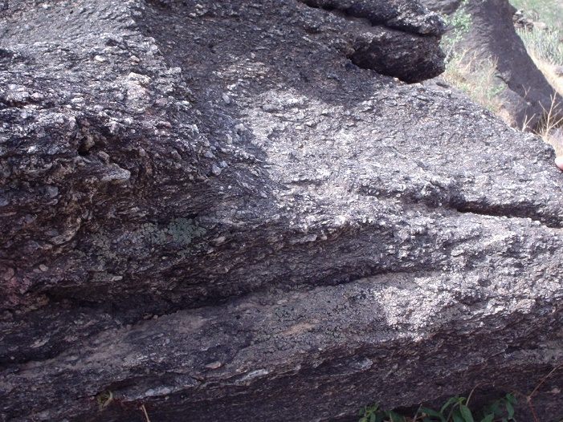
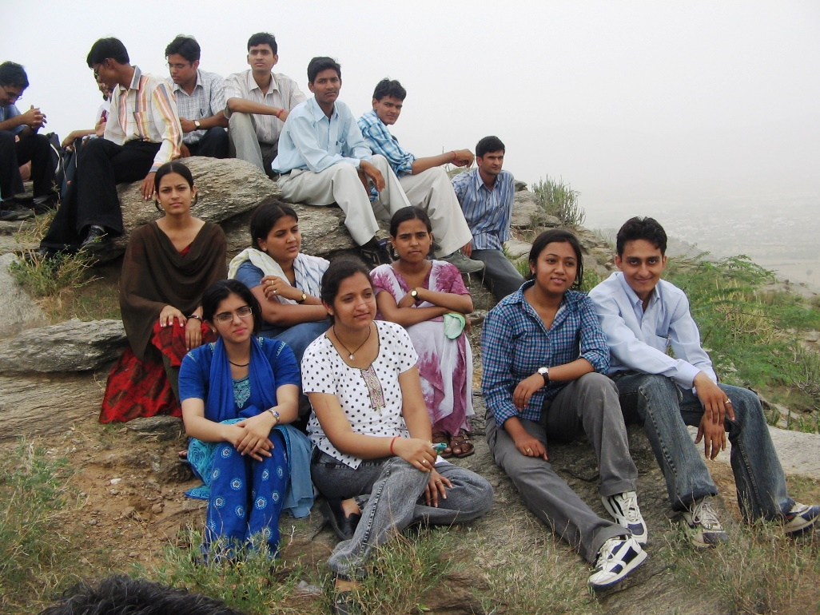
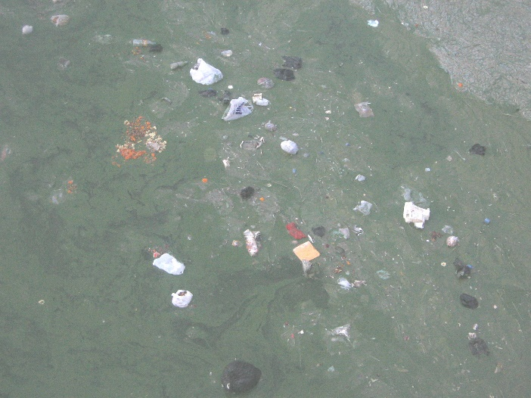
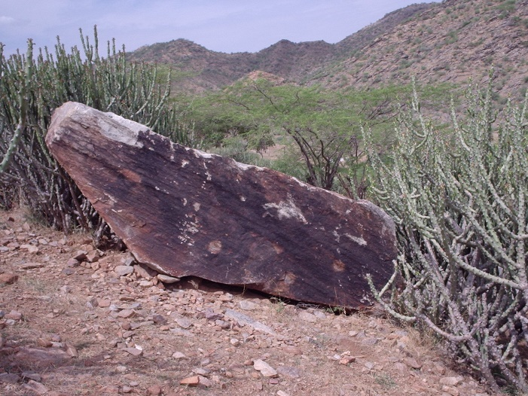
ConServe: Field Experience

Slide 21
आत्रेय व्याख्यानमाला
After Atreya –the physician in Takshashila who was born at Panchanad of Kashmir during Kanishka’s period. Atreya taught Agnivesh who in turn was the guru of Charak and thus inspired Charak Samhita- about Indian Medicinal System.
Tenth lecture: Dr. B. Ramakrishnan Microbiology Division IARI N Delhi Pumping iron: what do bacteria and archaea gain from? 12.3.2012
Eleventh lecture: Prof. Suparna Mukherjee, Centre for Environmental Science and Engineering, IIT Mumbai. Biofuel from Algae and Sustainability Considerations 26.7.2013
Twelfth lecture: Dr. Senthil Chinnasamy Biotechnology Division, Aban Infrastructure Pvt Ltd, Chennai Biofuels from Algae: Opportunities and Challenges in Technology Commercialization 11th October 2014
Thirteenth lecture: Dr. Pankaj Goyal, Central University of Rajasthan Cofilin: A small protein with big responsibilities" December the 17th, 2018
Fourteenth Lecture: Dr. (Ms) Jagjiwan Kapoor, General Manager, Progressive Life LLP, Dubai Quality mindset in Pharma and Biotech Industry 23.10.2021
Fifteenth Lecture: Dr. Ajit Kumar Shasany, Director, ICAR-National Institute of Plant Biotechnology, New Delhi on Aroma Biology and Livelihood Security 25.11.2021

Slide 22
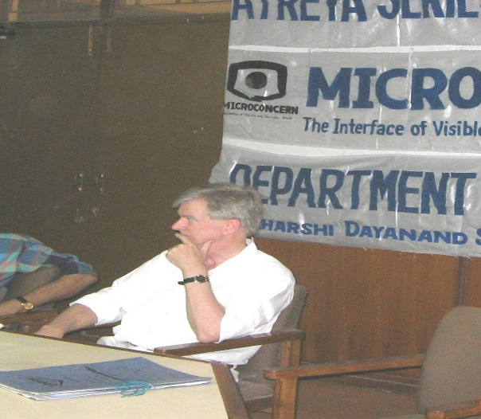
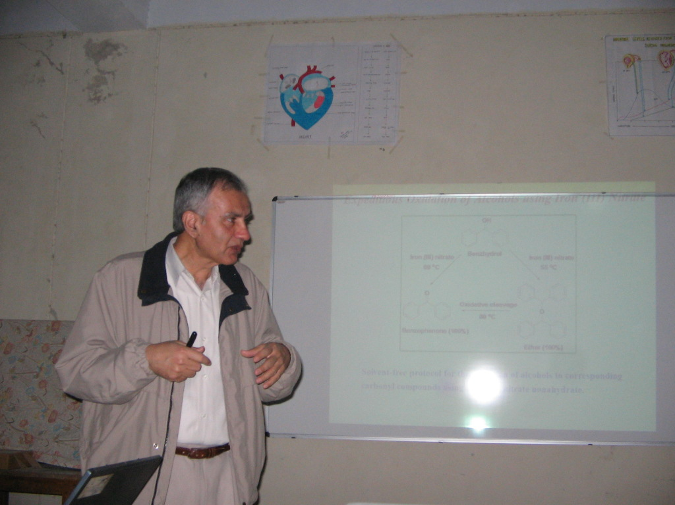
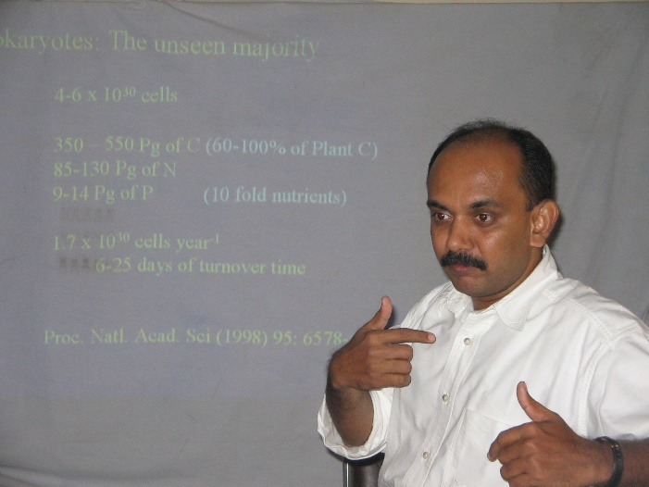
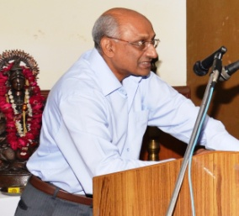
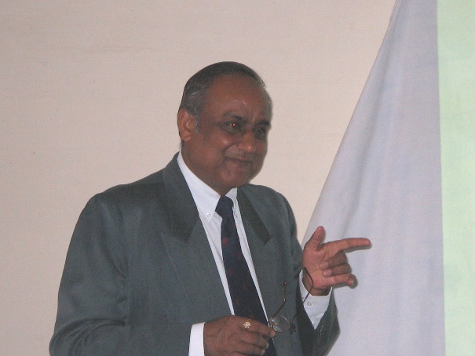

VISITORS
Dr. Victor Wrey, Germany
Dr. R S Verma, USEPA
Prof. B.N. Johri, Bhopal
Prof. B.D. Kasuhik, N Delhi
Dr. B. Ramakrishnan, Cuttack

Slide 23
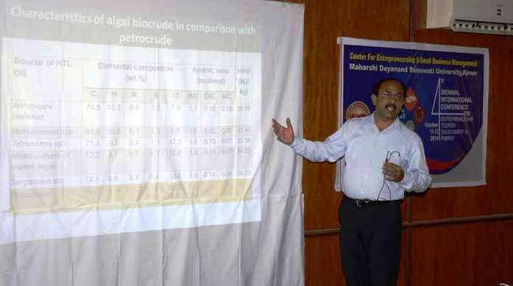
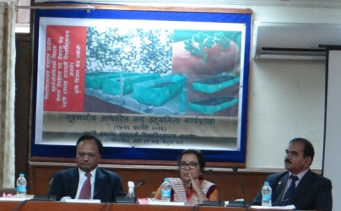
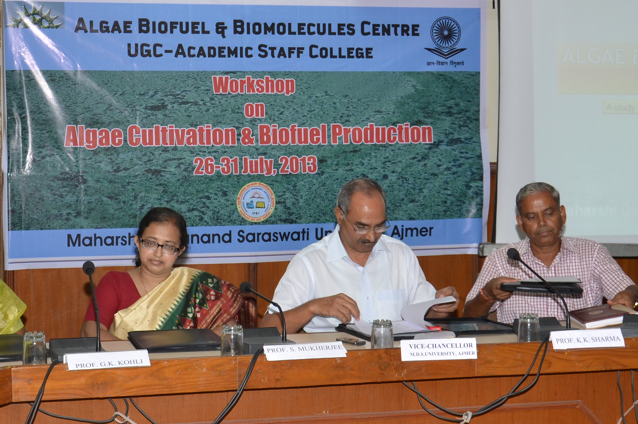
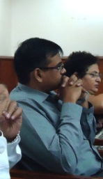
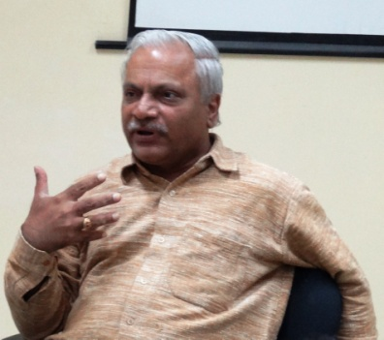
VISITORS
Dr. Senthil Chinnasamy, Aban Infrastructure, Chennai
Dr. Radha Prasanna, IARI, N Delhi
Dr. Pavan Jutur, ICGEB, N Delhi
Dr. M. Krishnamohan, BISR, Jaipur
Dr. Suparna Mukhaerjee, IIT Bombay

Slide 24
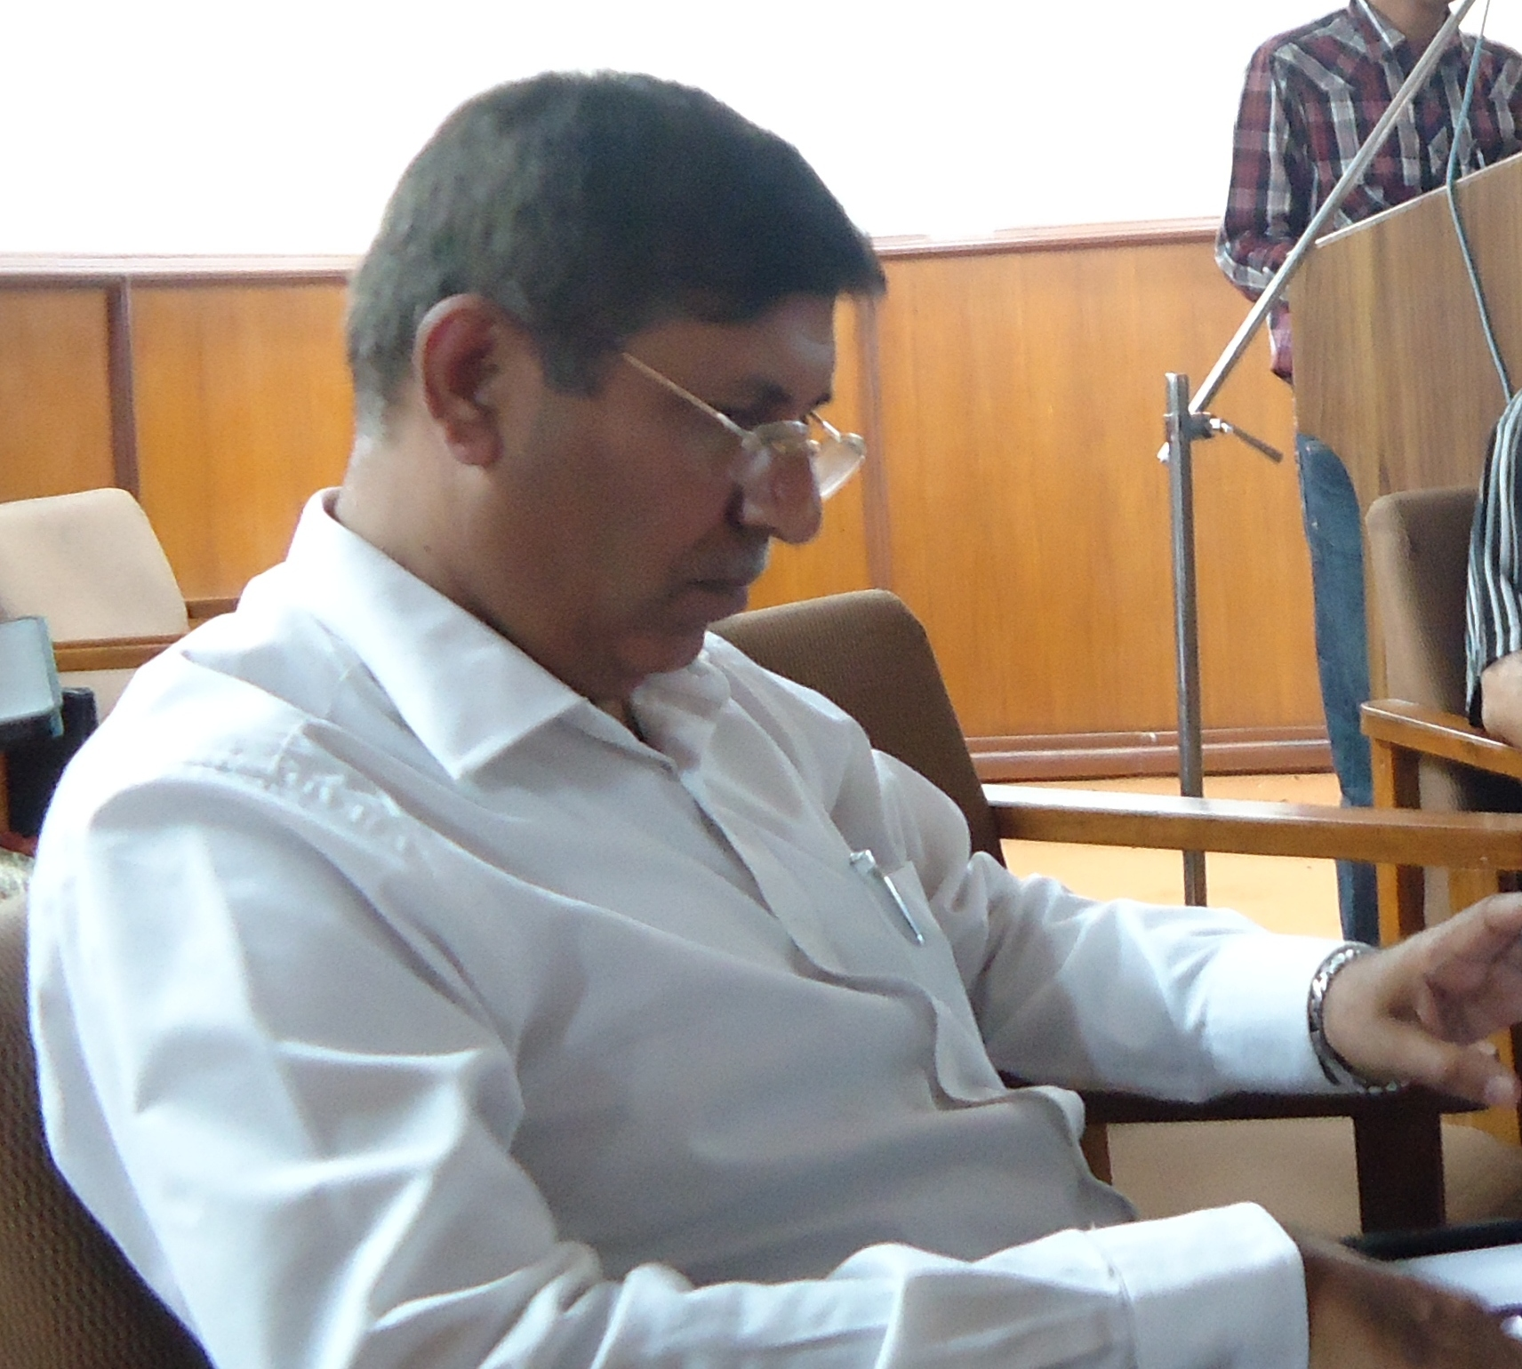
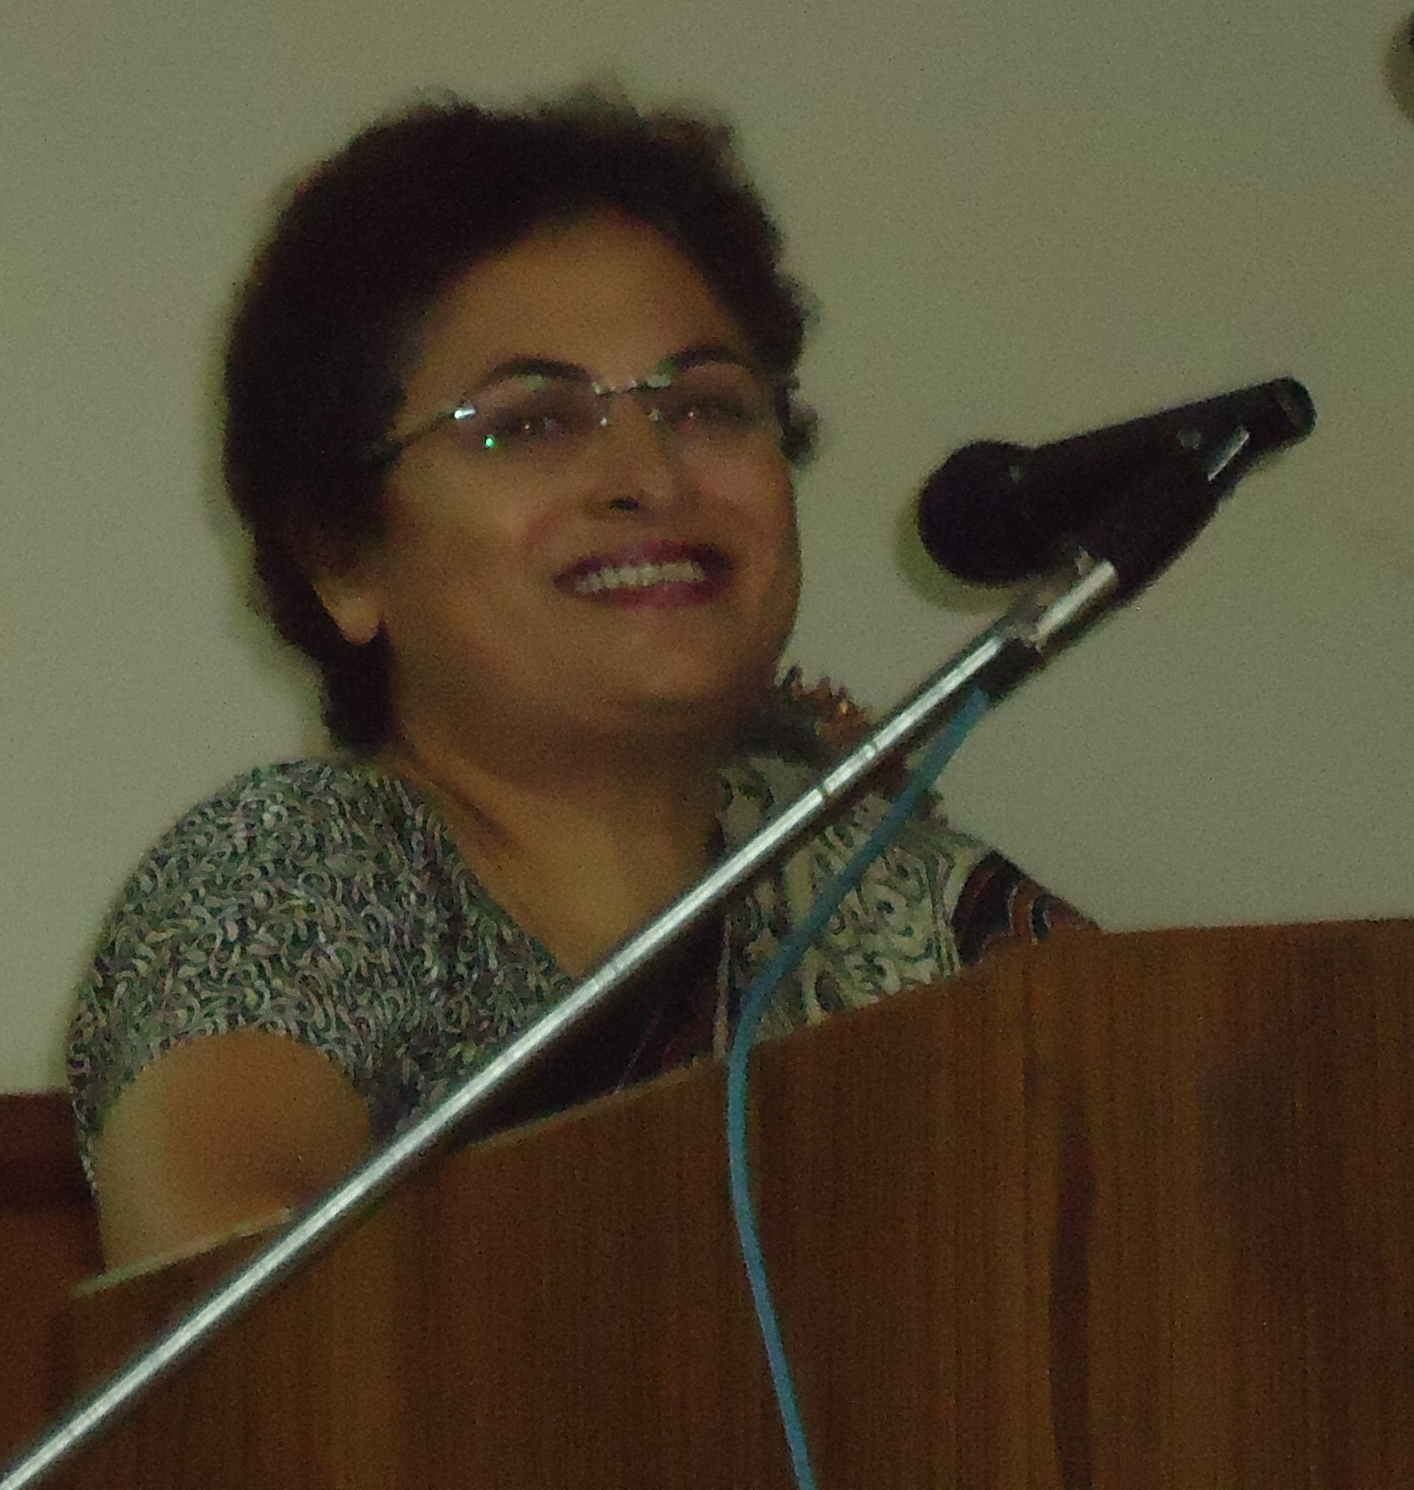
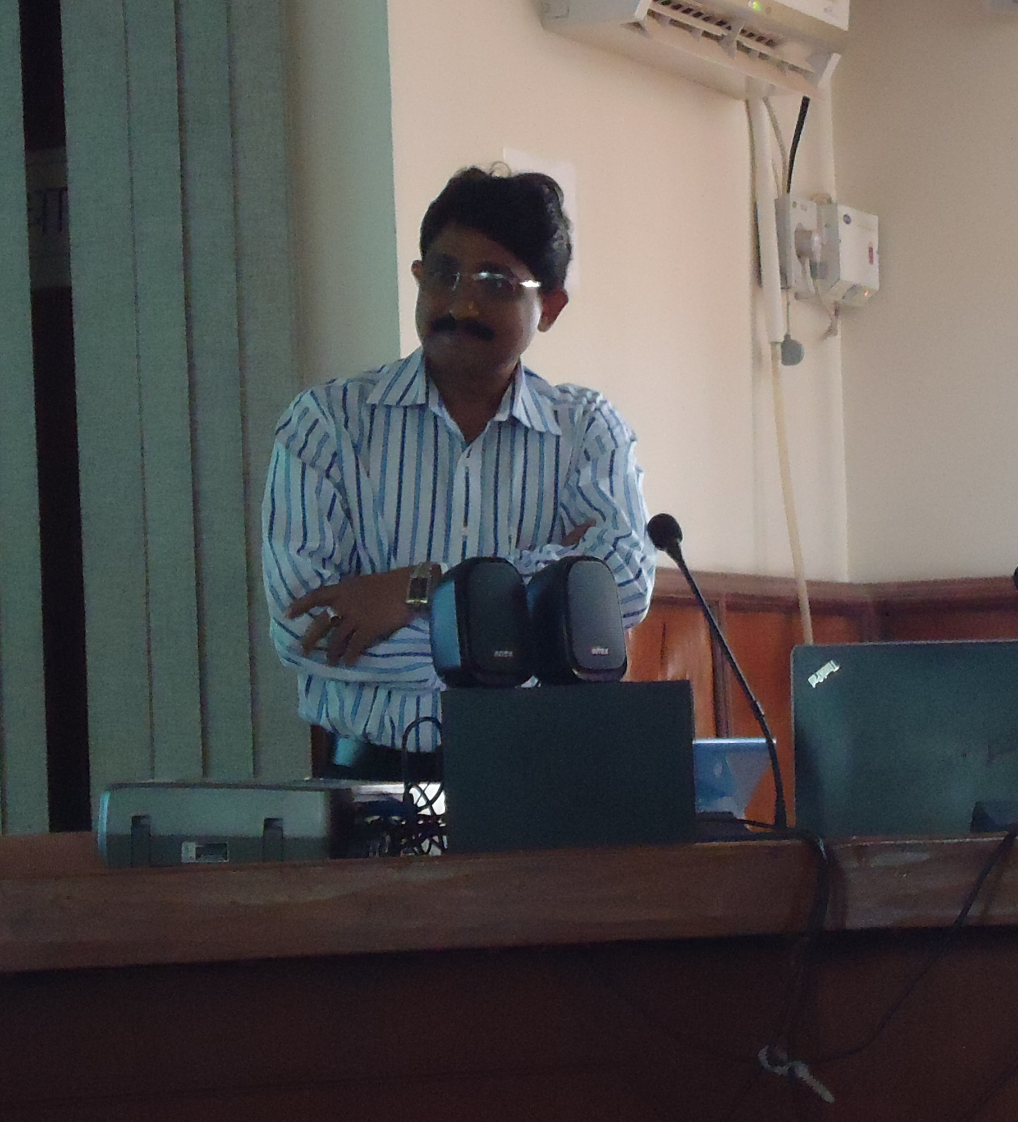
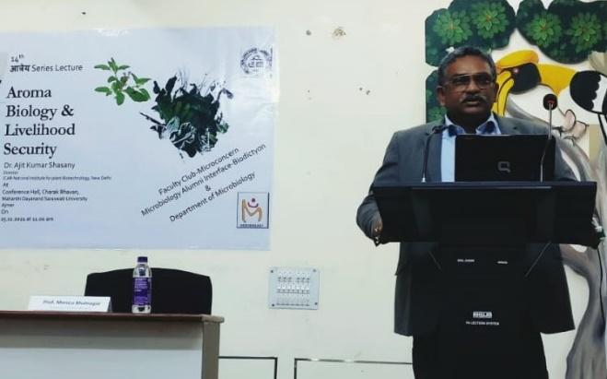
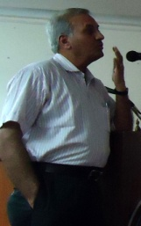
VISITORS
Dr. Sunil Pabbi, IARI, N Delhi
Dr. Dolly Wattal Dhar, IARI,
N Delhi
Dr. Ajit Shasany, Director, National Institute for Plant Biotechnology, New Delhi
Prof. Ramkrishna Sen, IIT Kharagpur
Prof. S K Bhatnagar, CCS Univ of Agric & Tech, Meerut

Slide 25
The wall magazine
ZoomIn is the noosphere of students i.e., the planet managed by mind.
A wall magazine run by students. It supports the literary and other creative activities, Interesting information about microorganisms and biotechnology, news about activities, word of the day, achievement of faculty/students/ alumni and portions for notices and information from Biodictyon and Microconcern are put up on it.
IN
ZOOM

Slide 26
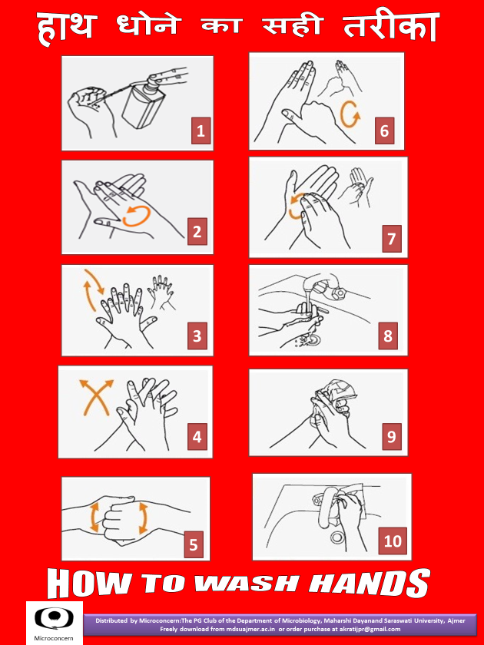
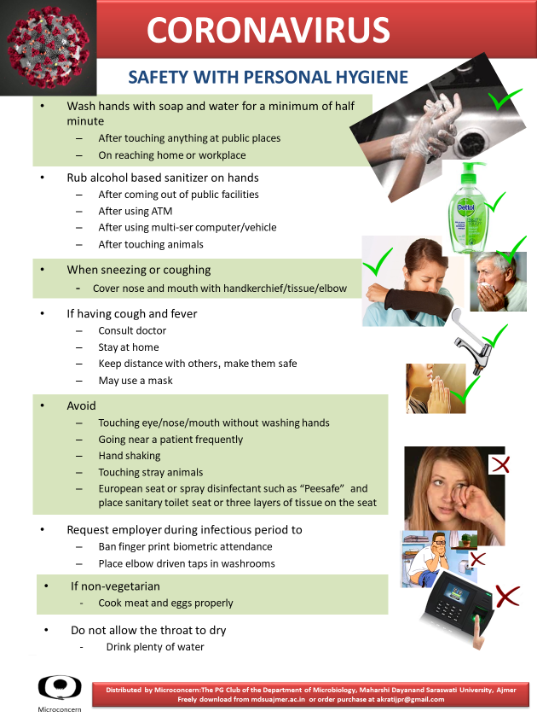
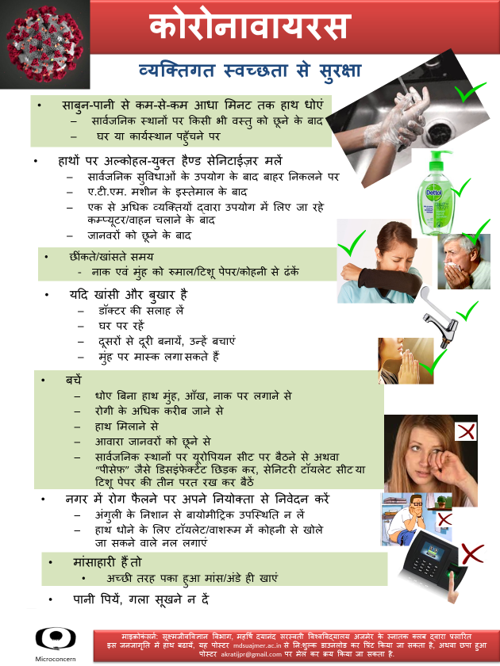
माधवकर
Awareness Campaign for Covid19
12.3.2020: Posters for How to wash the Hands and pasting them above the wash basins at the public facilities such as Sulabh Shauchalaya, Bus stands, Railway Stations, Cinema Halls, Malls,
important Restaurants, Hospitals, University buildings, Guest Houses, crowded offices such as
RPSC, CBSE, RBSE, Collectorate, Hindustan Zinc, Court etc and support services such as police, central Jail.

Slide 27
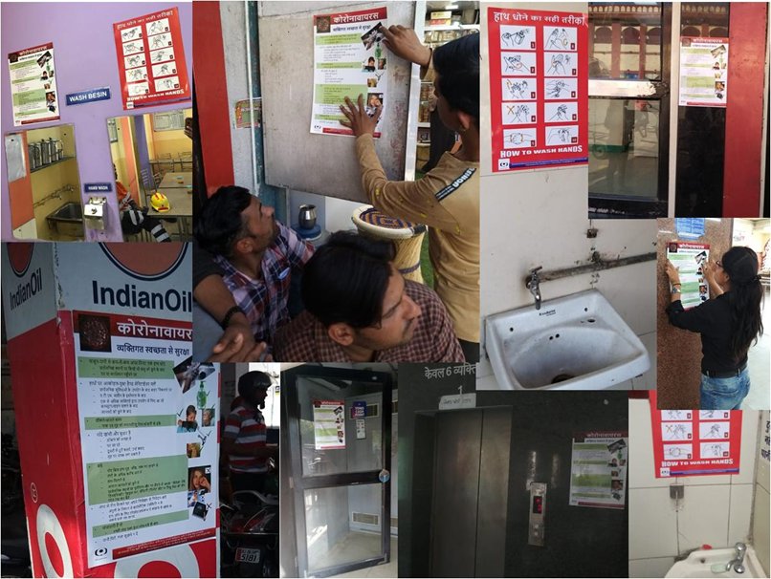
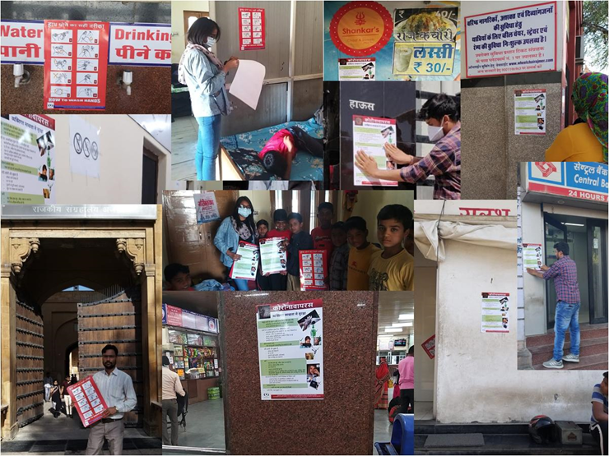
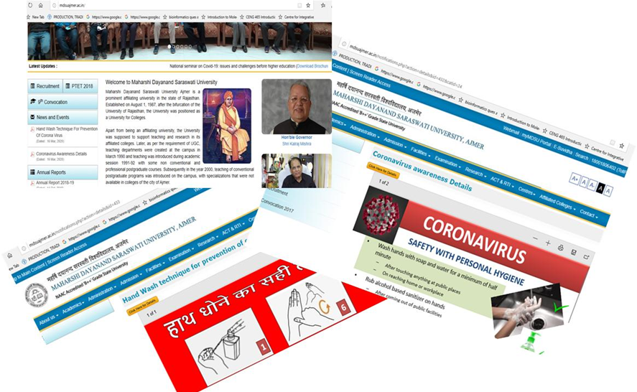
माधवकर
Awareness Campaign for Covid19
Demonstrations of hand wash and other important preventives were held between 12th May 2020 to 20th May 2020 in the major offices near the University viz. Hindustan Zinc, Central Jail, IG Police office, Sophia College, RPSC, sections of the University and for the University Safai Karmacharies.

Slide 28
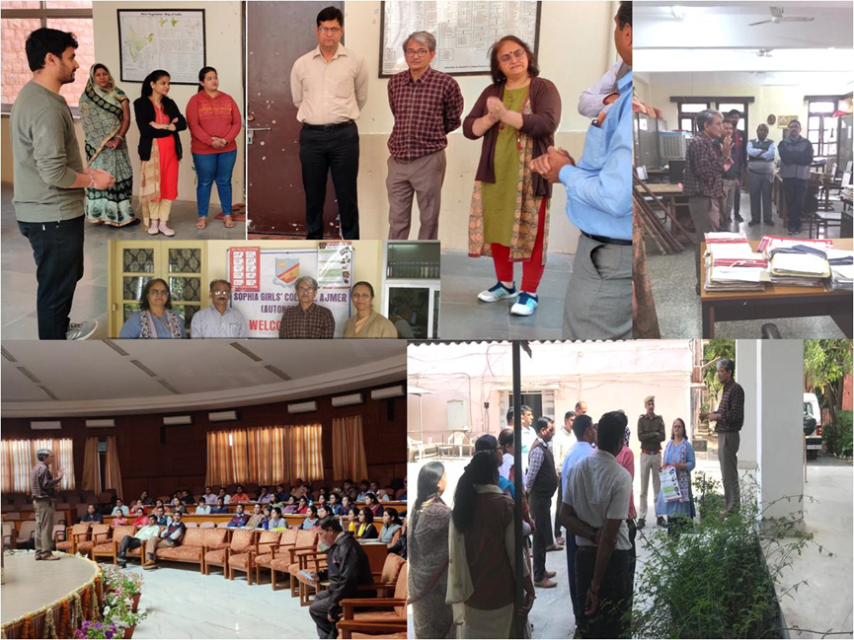
माधवकर
Awareness Campaign for Covid19
Sanitizer was not available in the market at the beginning of the pandemic in India. All aseptic techniques in Microbiology begin with sanitization of hands with 70% Isopropyl Alcohol and 3% glycerol, which was also recommended by the WHO and CDC to kill the Coronavirus (SARS-COV2) thus the Microconcern prepared sanitizer and distributed it in all administrative sections and departments of the University from 15th May 2020 till the start of the Lockdown I. Staff members were also provided the same. Office of RPSC requested us to prepare it for them, thus Microconcern prepared it for them.

Slide 29
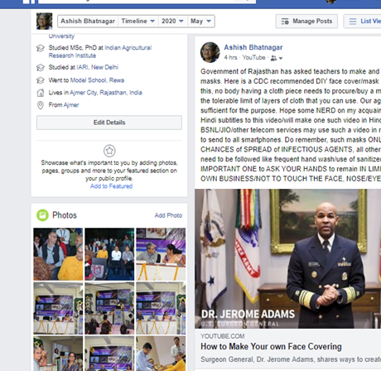
माधवकर
Awareness Campaign for Covid19
Masks: Facebook to inform how to prepare own face cover based on CDC video

Slide 30
Biodictyon: The Alumni Interface
The Network of Life
Biodictyon
Lectures/Training/
Workshops
Mentoring
Coenose:
The community act

Slide 31
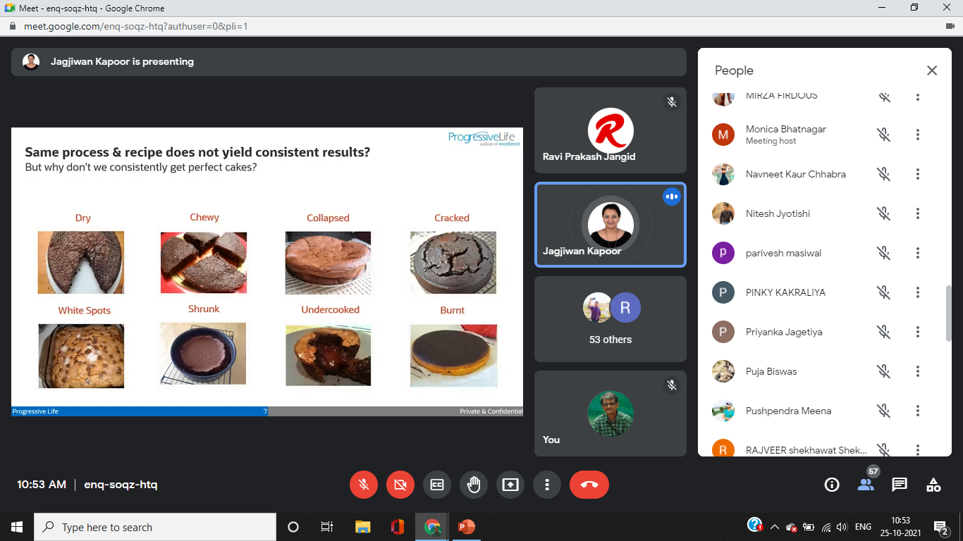
14th Atrey lecture, Jagjeevan Kapoor
General Manager, Progressive Life LLP, Dubai “Quality mindset in Pharma and Biotech Industry” 23.10.2021

Slide 32
Funds generated till 2020-21
Professional faculty fund fee ~Rs. 75 lakh
SFS M.Sc. BT Rs. ~45.7 lakh + M.Phil. Rs. 6.2L
SFS M.Sc. Biotechnology revived since 2020-21 Rs. 2.2 L
Research Projects
DBT Rs. 19 lakh and Rs. 46.45 Lakh
DST Rs. 22 Lakh
CSIR/DST Rs. 5 lakh
MEF Rs. 33.61 lakh
PDA Rs. 50 lakh
CSIR/Rajiv Gandhi JRF Rs. ~ 9.5 lakh
TOTAL TILL DATE ~ Rs. 314.66 lakh
Notes:
Teaching Learning & Resources NIRF 30%

Slide 33
Student Support
Infrastructure
  Instruments worth ~Rs. 83L through extra mural funding
  Additionally, equipment of Rs. 5 lakh sanctioned in 2021 PDA project on moist wound dressings
Notes:
Teaching Learning & Resources NIRF 30%

Slide 34
Graduation Outcome
Student Profile 2020:
  25 batches-472 passouts in MSc Microbiology
  4 batches-75 passouts in MSc Biotechnology
  3 batches-18 passouts M Phil Microbiology
  2 batches-10 passouts M Phil Biotechnology
  10 PhDs awarded
  TOTAL: 585
Notes:
NIRF 20%

Slide 35
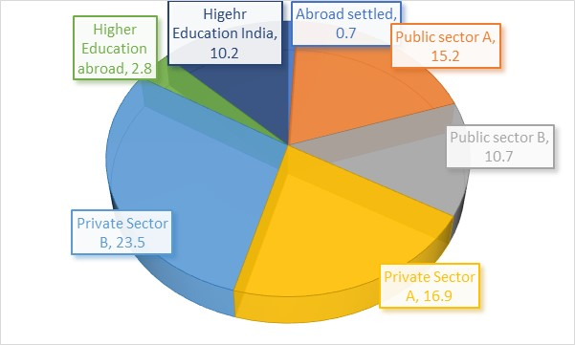
Graduation Outcome
  Verifiable record of 243 alumni (46% of total 585 are females, many of whom are home makers and thus not available to list)
  Settled Abroad: 10 (0.7%)
  Public sector: 37+26= 63 (10.5%)
  Private sector: 41+57= 98 (16.3%)
  Higher Education abroad: 20 (2.8% )
  Higher education in India: 61 (10.2%)
Notes:
NIRF 20% Also Teaching Learning Evaluation of NAAC (20%) and Teaching Learning & Resources NIRF 30%

Slide 36
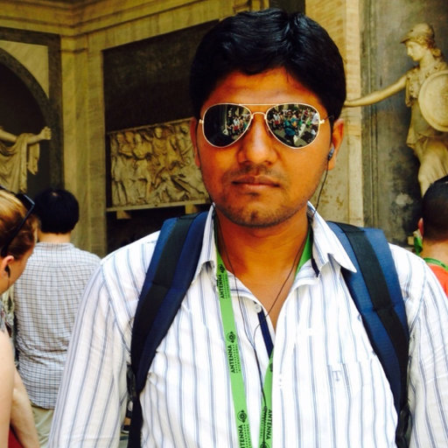
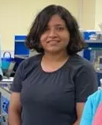


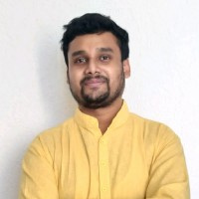
Glorious moments
Ms. Sapna Jha could publish M.Sc. dissertation work in Biotechnology Letters (JIF 0.967).
Mr. Bhupendra Verma joined Indian Institute of Science, Bangalore for Ph.D.
Ms. Arti Sharma joined IIT, Jodhpur for Ph.D.
Mr. Hemraj Chhipa awarded Endeavour Research Fellowship in Australia
Mr. Rishiraj Chhipa stood amongst the first 100 in CSIR JRF test
Mr. Kishan Jain secured 52 rank in GATE

Slide 37
Reach in Higher Education
100 qualified National level tests
Coverage of National labs
National Institutes: Bangalore: IISc, Pune: IISER, National Centre for Cell Science & NCL, Jodhpur: Defence lab, IIT & CAZARI; Lucknow: CDRI* & IITR; Goa: NIO, Delhi: IARI, IIT, NII, Defence lab, CSIR-IGIB, Gwalior: Defence lab, Mohali: IISER, Pilani: BITS, Jaipur: BISR, Dehradun: FRI, Karnal: NDRI, Anand: NDDB
Universities: DU & JNU New Delhi; BHU Varanasi; GBPUA&T Pantnagar; MSU Vadodara, PU Chandigarh CUoR, MDSU, Ajmer; JLNTU Hyderabad; KGMU Lucknow

Slide 38
Illustrious alumni (Private sector)
Vishal Sharma: Cofounder-Director, Vienni Training & Consulting LLP, Bangalore
Dr. Rajesh Soni Proteomics Core Manager at Herbert Irving Comprehensive Cancer Center New York
Dr. Sanjay Pareek-Vice President, Vikas WSP, Jodhpur
Dr. Ritu Singh, Sr Regulatory and Quality Specialist, Ortho Clinical Diagnostics, Melbourne Australia
Dr. Jainendra Jain: Operation Specialist, Biobig Healthcare Solutions Pvt Ltd, Chandigarh
Ramesh Solanki: Manager customer technical support, Shankarpack Poland
Ekta Chopra-Ranbaxy, Manish Bhatnagar-J Mitra Diagnostics, Jeet Singh Khushdil-Thermo Fisher Scientific, Aroop Chatterjee-Glaxo, Bitthal Lavania-Dominos, Ramesh Chauhan-Redico, Abhiman Sagar-Cadila Pharma, Ghanshyam Dhakar-CottonConnect, Amit Sukhwal R,aunak Dholiya, Durgesh Soni-Sun Pharma, Badal Nagar, Harish Chandra Singh-Dabur Pharma, Shikha Jhanwar, Anshuj Sharma-IPCA, Moola Ram-Usha Remedies, Neeraj Sharma-Dabur, Vijay Sharma-SABMiller, Sumit Kumar-Zydus Cadila

Slide 39
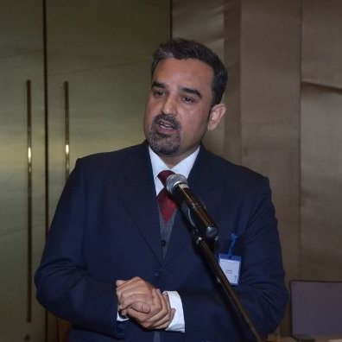
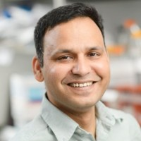
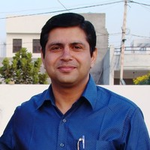
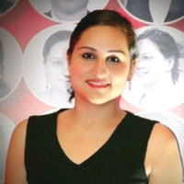
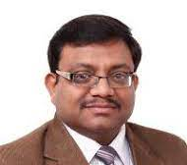
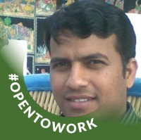
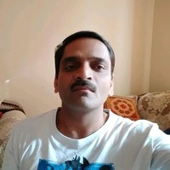
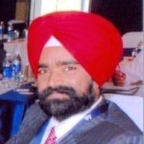






Slide 40
Illustrious alumni (Public sector)
Dr. Manohar Lal Chaudhary, Scientists E, National Institute of Virology Pune
Prof. Pradip Varma, Central University of Rajasthan
Dr. Bhupendra Verma, Assistant Professor, AIIMS, New Delhi
Dr. Sanjay Khandelwal Assistant Professor Duke University Medical Centre Durham USA
Dr. Manish Sharma, Sr. Lecturer (Microbiology), Texas State University
Dr. Arshad Khan_Assistant Professor University of Texas
Dr. Sarvesh Soni, Research Scientist, RMIT University Melbourne Australia
Dr. Renu Yadav, Associate Professor, Central University of Haryana
Dr. Dharmesh Harwani, Dr. Gautam Meghwanshi, Dr. Abhishek Vashishtha- Associate Professor, MGS University
Dr. Hemraj Chhipa, Asstt Professor, College of Horticulture & Forestry, Jhalawar
Dr. Chandraveer Charan, Lecturer, CDFST, MPU Ag & Tech, Udaipur
Pooja Gupta; Dy Principal, Capella State High School, Australia
Dr. Krishna Saharan, Assistant Professor, Agriculture University Jodhpur
Dr. Mukesh K Meghwanshi- Scientist D, Defence Research lab Tezpur
Dr. Anand Jain Project scientist, National Center for Polar and Ocean Research, Vasco da Gama
Vimlendu Pandey, Manager, Quality control at Ministry of Food Processing Industries, GOI, New Delhi
Rakesh Roshan, Sr. Scientific Officer, Forensic Science Department, Kota
Ajay Chandel, Scientist B, Bureau of Indian Standards, Bhopal

Slide 41
















Slide 42
Illustrious alumni (Public sector)
Bhanwar Singh Charan- Squadron Leader, IAF
Annie Jacob-Flight Lieutenant, IAF
Bank Manager: Surajbhan Pawaria-Canara Bank, Om Prakash Mehra-Central Bank of India, Pooja Udenia-Bank of Baroda, Sanjay K Rohilla-Union Bank of India, Subhash Meena- Rajasthan Gramin Bank, Chandrakant Sen-Rajasthan Cooperative Bank, Abhinav Kumawat-Indian Bank, Rakesh Meena- Sarv Haryana Gramin Bank, Laxmi Narayan Meena: SBI, Poonam Yadav- Bank of Baroda, Subhash Kumawat: Bank of Baroda, , Ram Niwas Chahar-Bank of Baroda, Sunil Jeph, Manohari Singh
RAS: Jaishree Naruka, Deepti Mishra, Maneeta Singh Rathore, Bhavna Poonia

Slide 43
Student Progression
Progression to higher studies and/or to employment
IISc Entrance for PhD: 1
CSIR-UGC NET JRF: 25
GATE 13
One secured rank 52 another within 100
ICMR JRF -3
CSIR-UGC NET LS 12
ICAR NET LS 6
SLET 5
GRE 2
TOEFL 1
UGC BSR meritorious student scholarship 1
CDSE 1
Air Force SSB 2
Probationary Officers 14
RAS 4
RPSC 1
Pollution Control Board 1
Forensic Science Department 1
Verifiable record of 100 who qualified National Level examinations
Notes:
NIRF 20%

Slide 44
Best Practices
Algae Biofuel & Biomolecules Centre
First Interdisciplinary Research Centre (5 departments, 9 faculty collaborators) of the Universities in the State: Algae Biofuel & Biomolecules Centre (Est 3.3.2011)
Only research centre with ZERO financial support from the University
Only research centre with 5 papers (>2 JIF), One book chapter published by Wiley, 26 paper presentations, 12 invited lectures, 59 students trained in algae
Notes:
Institutional Values and Best Practices (NAAC 10%)

Slide 45


ALGAE BIOFUEL & BIOMOLECULES CENTRE
A study centre established in 2011 in lines of Section 5 (d) of the University Act
Since 03.03.2011
DBT, GOI funded Project: (30.1.17-29.7.18 ~Rs. 49 lakh)
Developing low water demanding cultivation systems for algae in Rajasthan
Parenteral Drug Association funded project (21.3.18-20.3.23, Rs. 50 lakh):
Moist bioactive cellulose biocomposites for advanced wound care

Slide 46












Best Practices
FOR LIFE
BIOSKILLS & BIOENTERPRISES CENTRE
A Centre for learning skills through life sciences
MAHARSHI DAYANAND SARASWATI UNIVERSITY AJMER
Since 2019

Slide 47
Research and Innovation
Research (Rs. 1.81 crores of Extramural funding (Maximum in the University)
  Only department with national and international collaborations and part of prestigious Earth Microbiome Project
  First Nationally coordinated project: ProMiC
  Longest running project (13 years) in the University
  1st interinstitutional collaborative project (Rs. 46.45 lakh) coordinated by faculty at MDS University Ajmer
  1st Interdisciplinary Research Centre of the University and the State too: Algae Biofuel & Biomolecules Centre
  1st and only Private sector (PDA) funded research project of the University (Rs. 50 lakh)
Notes:
Research, Innovation and Extension (NAAC 25%)
Research and Professional Practice (NIRF 30%)

Slide 48
Two Research centres : Nationally recognised and externally funded
Notes:
Research, Innovation and Extension (NAAC 25%)
Research and Professional Practice (NIRF 30%)

Slide 49









Satellite Centre for Microalgal Biodiversity in Arid Zones of Rajasthan
(DBT, GoI, ~Rs. 19 lakh) 23.7.1999-31.10.2003
First externally funded major Research Project in Life Science in the University

Slide 50
Prosthecate Bacteria & Micrococcus Centre
(MoEF, GOI, ~Rs. 30 lakh) 25.3.2000-31.3.12
Longest running Major Research Project of the University
  Prosthecate Bacteria & Micrococcus Centre under All India Coordinated Project on Taxonomy of Ministry of Environment & Forests, Government of India (Rs. 33 lakh: 2000-2013)

Slide 51

Competence of the Permanent Faculty
Average Thompson Reuter journal impact factor for the “journals published in” is 1.038 that excludes paper in Nature as part of The Earth Microbiome Project, including this paper the average IF is 1.995.
Post-Doctoral Research Associate, Biorefining and Carbon Cycling Program, Department of Biological and Agricultural Engineering, The University of Georgia, Athens GA 30602.
Amongst Top 25 of Science Direct Science Direct listed Microalgae cultivation in a wastewater dominated by carpet mill effluents for biofuel applications
Third best paper award by International Journal of Molecular Science, 2013
Rotary Club Ajmer Metro Certificate of Appreciation for outstanding performance in the field of education 2016
Young Scientist (Bioenergy) Award, 2010: Society for Plant Research
Commonwealth Academic staff fellowships Reserve list for the project titled Cyanobacterial Biofilms: Architecture and Response to Stress 2007
Selected as Senior Manager for Algal Biofuels Project of Reliance Energy, Hyderabad at Kakinada, butdid not join 2007
IARI Senior Research Fellow 1989-93 for Ph D in Microbiology
Qualified CSIR-UGC National Eligibility Test for lecturership in Life Sciences 1990
Gold Medal at IARI New Delhi in M.Sc. Microbiology
Aspee Gold Medal and Bank of Baroda Cash Prize in BSc (Ag),
Throughout Scholarship (BSc (Ag) at JNKVV Jabalpur, MSc (Microbiol) & PhD at IARI, New Delhi
Dr. Ashish Bhatnagar, Professor

Slide 52

Competence of the Permanent Faculty
Awarded Best Oral Paper Presentation: Third Global Sustainable Biotech Congress, 2014. Dec 1-5, for Wound Healing by soluble plant biopolymer of Moringa oleifera organized by North Maharashtra University, Jalgaon, Global Biotech Forum, Nagpur and Cetys University, Mexico.
2nd best poster award to Neetu Manglani for the poster paper titled Production and optimization of alkaline serine keratinase exhibiting potential dehairing activity. Neetu Mangalani, Monica Bhatnagar, Ashish Bhatnagar in the International Conference on Biotechnology: A rendezvous with Basic Sciences for Global Prosperity. 26-27 Dec 2012, New Delhi. Society for Plant Research, New Delhi
Third Best Poster Award to Laxmi Parwani in the International Conference on Biotechnology: A Rendezvous with Basic Sciences for Global Prosperity for the Poster paper titled Potential of Gum Acacia in wound management: A new approach by Laxmi Parwani, Monica Bhatnagar, Ashish Bhatnagar held at NASC Complex, New Delhi December 26-27, 2012
Third position for Young Scientist Award to Laxmi Parwani in the International Conference on Microorganisms in Environmental Management and Biotechnology for the oral presentation titled Biocompatible polymers from desert cyanobacteria for wound management by Laxmi Parwani, Monica Bhatnagar, Ashish Bhatnagar, Vinay Sharma held at Barkatullah University Bhopal July 1-3, 2011
Third Best Poster Award to Laxmi Parwani for the poster paper titled A novel biocompatible wound dressing based on gum Acacia by Laxmi Parwani, Monica Bhatnagar, Ashish Bhatnagar, Vinay Sharma in the International Conference on Green Chemistry at Jaipur organized by Central University of Rajasthan December 7-9, 2011
IARI Senior Research Fellow1993-1997
Qualified Council for Scientific &Industrial Research & University Grants Commission National Eligibility Test for Junior Research Fellowship in Life Science 1997
Qualified-Indian Council for Agricultural Research National Eligibility Test for Senior Research Fellowship and Lecturership in Microbiology 1994
IARI Gold medal 1993
IARI Junior Research Fellow1991-1993
Qualified National Talent Search Contest of the Central Institute of General Knowledge Learning, 1986
Dr. Monica Bhatnagar,
Professor

Slide 53

Research & Innovation
Only faculty members to bring the University on Internationally the most renowned journal “Nature” with Journal Impact Factor of 43
Rare for the faculty in the State Universities of Rajasthan to have this distinction
Notes:
Research, Innovation and Extension (NAAC 25%)
Research and Professional Practice (NIRF 30%)

Slide 54
Research and Innovation
Only faculty in University that filed 4 US patents out of which 1 has been granted.
Difficult to obtain patent in Life Sciences
Notes:
Research, Innovation and Extension (NAAC 25%)
Research and Professional Practice (NIRF 30%)

Slide 55
Research and Innovation
Faculty with no close peer in University in terms of citations
9 papers with >100 citations
Ashish Bhatnagar | All | Since 2016 till 30.11.2021
Citations | 4150 | 2945
h-index | 18 | 17
i10-index | 28 | 22
Monica Bhatnagar | All | Since 2016till 30.11.2021
Citations | 1980 | 1634
h-index | 12 | 11
i10-index | 15 | 14
Based on Google Scholar
Notes:
Research, Innovation and Extension (NAAC 25%)
Research and Professional Practice (NIRF 30%)

Slide 56
Research & Innovation
Listed amongst Top 25 hottest of Science Direct Microalgae cultivation in a wastewater dominated by carpet mill effluents for biofuel applications. By Chinnasamy, S.; Bhatnagar, A.; Hunt, R.W.; Das, K.C. Bioresource Technology,101 (9): 2010:3097-3105
Science Direct: A service for Elsevier Journals with a database of 2500 journals and 11 million users worldwide. Updates its list of top 25 hottest Articles based on number of downloads of an article. It has 236 journals in Agricultural and Biological Sciences
Notes:
Research, Innovation and Extension (NAAC 25%)
Research and Professional Practice (NIRF 30%)

Slide 57

Ashish Bhatnagar is a reviewer on few of the best journals of the world and has reviewed 43 papers

Slide 58
International Presentations
Fuel algae cultivation in municipal wastewater: Some strategic lessons from Chlorella minutissima. 31st Symposium on Biotechnology for Fuels & Chemicals 3-6 May 2009 San Fransisco (USA) (Society for Industrial Microbiology)
Revisiting Biofuel Options for a thirsty, hungry and dark earth Fall Seminar Extension Lecture 27 August 2009 , Faculty of Engineering, University of Georgia, Athens (USA)
Wound management using Moringa oleifera seed polymer. First International Symposium on Moringa held at Manila (Philippines)15-18 November 2015. International Society for Horticultural Sciences

Slide 59

BISR, Jaipur
Rajasthan University, Jaipur
JNV University Jodhpur
IIS University, Jaipur
Banasthali Vidyapeeth, Banasthali
MLS University, Udaipur
Central University of Rajasthan, Jaipur
MGS University, Bikaner
JJT University, Jhunjhunu
Punjab University Chandigarh
Guru Nanak Dev University, Amritsar
Thapar Institute of Engineering & technology, Patiala
GB Pant University of Agriculture & Technology, Pantnagar
Indian Agricultural Research Institute, New Delhi
Delhi University South Campus
Bhaskaracharya College of Applied Sciences
ICAR-NABAIM Kushmaur, Mau
Meerut University, Meerut
Invited Speaker/
Resource Person
Barkatullah University, Bhopal
RD University, Jabalpur
IIT Kharagpur
Indira Gandhi Agriculture University, Raipur
North Maharashtra University, Jalgaon
Central Rice Research Institute, Cuttack
Madras Christian College, Chennai

Slide 60
Thesis/
Project report Evaluations
GB Pant University of Agriculture & Technology, Pantnagar
Rajasthan University, Jaipur
JNV University Jodhpur
Central University of Rajasthan, Jaipur
Indian Agricultural Research Institute, New Delhi
Hamdard University, Delhi
Gujarat University, Ahmedabad
North Gujarat University, Patan
Saurashtra University, Rajkot
Dayalbag Institute, Agra
Banaras Hindu University, Varanasi
RD University, Jabalpur
APS University, Rewa
NIT Durgapur
Indira Gandhi Agriculture University, Raipur
Mumbai University, Mumbai
North Maharashtra University, Jalgaon
Marathwara University, Aurangabad
Agarkar Research Institute, Pune
A-IDEA NAARM Hyderabad
Tumkur University, Tumkur
Madras University, Chennai

Slide 61
Consultancy
  On the panel of evaluators of BIRAC (Biotechnology Industry Research Assistance Council) GOI
  On the panel of A-idea of ICAR-National Academy for Agricultural Research Management, Hyderabad for start-up evaluations in Microbiology
Notes:
(25%) Research, Innovation and Extension

Slide 62
Extension Activities
Two day workshop on Small Enterprise in Microbiology on 15-16 February 2016 imparted training on the importance and cultivation of Azolla, Blue Green Algae Biofertilizer, Spirulina and Vermicomposting. Out of 85 participants, 39 were rural youth representing 13 districts of Rajasthan, besides them there were 8 teachers, 5 research scholars, 1 retired agricultural officer, 1 medical officer and students at the university.
Awareness campaign by Microconcern (16.3.2020) for protection against coronavirus at campus, distribution of 900 posters in the city and the departments, providing sanitizer to the various sections of the University

Slide 63
Academic Collaborations
International
  Earth Microbiome Project (>500 investigators, 161 institutions)
  Material and Energy Research Institute of Iran, University of Hongkong; University of Georgia
  National
The Research project "Prosthecate Bacteria & Micrococcus Centre" was a Collaborative Unit of Centre for Research on Bacteria & Archaea under AICOPTAX of Ministry of Environment & Forests. National Coordinator was Prof. T. Satyanarayan, Delhi University South campus and the other collaborators are from, G.B. Pant University, Pantnagar, Banaras Hindu University, RD University Jabalpur and Agharkar Research Institute, Pune.
The Research project “Developing low water demanding cultivation systems for algae in Rajasthan” funded by DBT, GOI had CUoR as Collaborating Institute while MDS University Ajmer was the lead University
IARI New Delhi; IIEST Shibpur; NIT Durgapur; CUoR, Ajmer, NRCSS Ajmer and NGRC Pune are frequently involved in collaborative proposals

Slide 64
DEPARTMENT OF MICROBIOLOGY contributes maximum in The University
5 (80% marks of evaluation) out of 7 criteria of NAAC Accreditation
3 (80% marks of evaluation) out of 5 criteria of NIRF ranking

Slide 65
New Education Policy
Emphasis on | Action taken
Life skills such as communication, cooperation, teamwork, and resilience | Through mentoring, seminars, course on scientific writing, Group activities as Club, alumni association, joint projects
Extensive use of technology in teaching and learning | Use of Computers, Power point presentations, Online platform Wooqer for Microsphere and now Online teaching
Respect for diversity and respect for the local context in all curriculum, pedagogy, and policy, always keeping in mind that education is a concurrent subject | Included course contents as Biology of Extremes (Desert Microbiology) (Core course), Microbiology of Wastes and Waste Remediation (Disciplinary Elective), Hygiene and Microorganisms and Health dealing with new and emergent pathogens (Foundation courses)
Outstanding research as a co-requisite for outstanding education and development | As shown above

Slide 66
Compliance with New Education Policy
Multiple entries and multiple exits, Adopted but cancelled by the Academic Council since 2021
No hard separations between arts and sciences, The Curriculum has no restriction on subject choice of student in other departments and faculty
Multidisciplinarity and a holistic education No restrictions on students on interdisciplinary electives
Emphasis on conceptual understanding Emphasize learning through laboratory experiments, short term project, long term project, workshops/training (49% time of core courses) rather than rote learning and learning-for-exams.
Creativity and critical thinking to encourage logical decision-making and innovation through project works
Ethics and human & Constitutional values like empathy, respect for others, cleanliness, courtesy, democratic spirit, spirit of service, respect for public property, scientific temper, liberty, responsibility, pluralism, equality are inculcated through group activities, PG club, alumni association and foundation courses

Slide 67

Vision
Centre for Desert Microbiology & Biotechnology

Slide 68

Centre for Desert Microbiology
  Objective
  To study and teach Stress Biology of Microorganisms & Biotechnology for the hot arid environments
AIMS
Train and build up human resources
Identify stress tolerant germplasm of the unique arid habitats
Conserve microorganisms in vitro
Develop technology for agriculture and industry
Generate strategies for ecomanagement
Disseminate technology to the stakeholders (farmers, offices, NGOs and entrepreneurs)
Create awareness and sensitivity towards microorganisms

Slide 69

Inter-disciplinary Centre

Slide 70
Ken:
The Beyond
UG/School students’ Cross Talk Program
Why?
Declining interest in science
Absence of proper measures of assurance of quality of higher education
Growing privatization lead business of teaching is cheating unaware students and their parents
Breeding of population carrying tags of being expert but not at all capable to deal with their subject of specialization
Notes:
Beyond understanding of knowledge/comprehension

Slide 71
Ken:
The Beyond
Expose budding beings to the pleasure of discovery, challenges that are ahead and to the fact that development moves on the wheels of science and technology
Informing what is expected by industry, institutes and other stakeholders
Information on possible enterprises
Methods to evaluate institutes/departments that impart teaching in biology-based courses

Slide 72
Thank you for your kind attention
स्वान्तः सुखाय

